Slide 1

Advanced Corporate Finance (LL4554V/LL5554V/LLJ5554V/LL6554V) 11. valuing options
Kenneth Khoo
kenneth.khoo@nus.edu.sg

Slide 2
Today’s Roadmap
A Simple Option-Valuation Model (Ch. 22-1)
Why DCF doesn’t work for options
Replicating portfolio approach
Risk-neutral valuation
The Binomial Method (Ch. 22-2)
Multi-period binomial trees
Working backward through the tree
The Black-Scholes Formula (Ch. 22-3)
The formula and its inputs
Using Black-Scholes in practice
Black-Scholes in Action (Ch. 22-4)
Implied volatility and the VIX
Dividends and early exercise

Slide 3

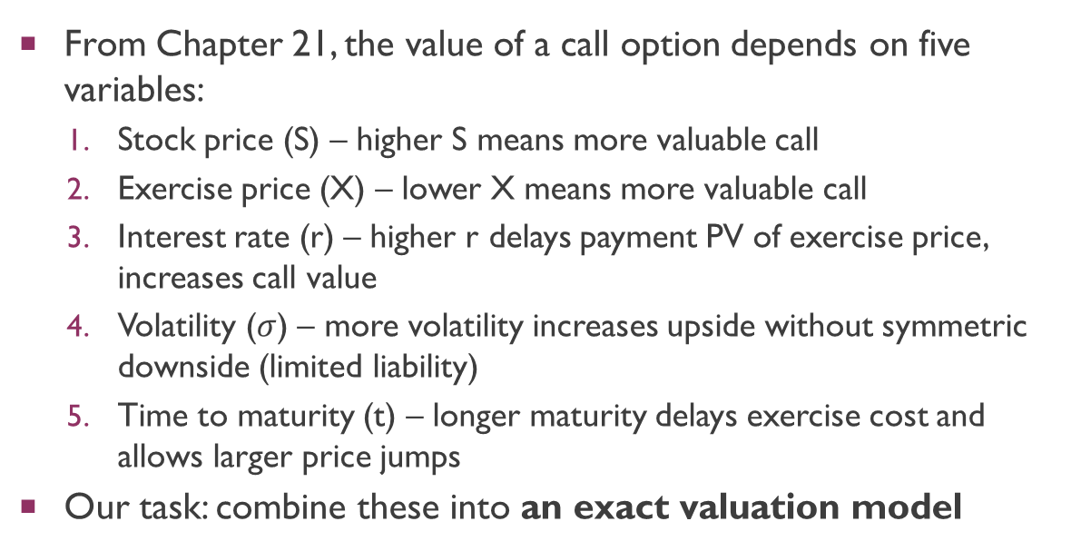
Recap: Five Factors Driving Option Value
From Chapter 21, the value of a call option depends on five variables:
Stock price (S) – higher S means more valuable call
Exercise price (X) – lower X means more valuable call
Interest rate (r) – higher r delays payment PV of exercise price, increases call value
Volatility ($σ$) – more volatility increases upside without symmetric downside (limited liability)
Time to maturity (t) – longer maturity delays exercise cost and allows larger price jumps
Our task: combine these into an exact valuation model
Notes:
Investors who acquire stock by way of a call option are buying on credit. They pay the purchase price of the option today, but they don't pay the exercise price until they actually exercise the option. The delay in payment is particularly valuable if interest rates are high and the option has a long maturity.

Slide 4
Why Discounted Cash Flow Fails for Options
Standard DCF: estimate expected cash flows, discount at opportunity cost of capital
Problem: an option’s risk changes every time the stock price moves
Deep in-the-money call is almost certain to be exercised → relatively safe
Out-of-the-money call may expire worthless → very risky
The option’s discount rate changes day by day, even hour by hour
Key rule: the higher the stock price relative to the exercise price, the safer the call option
Because there is no single constant discount rate, we need a different approach
Solution: the replicating portfolio and risk-neutral methods

Slide 5
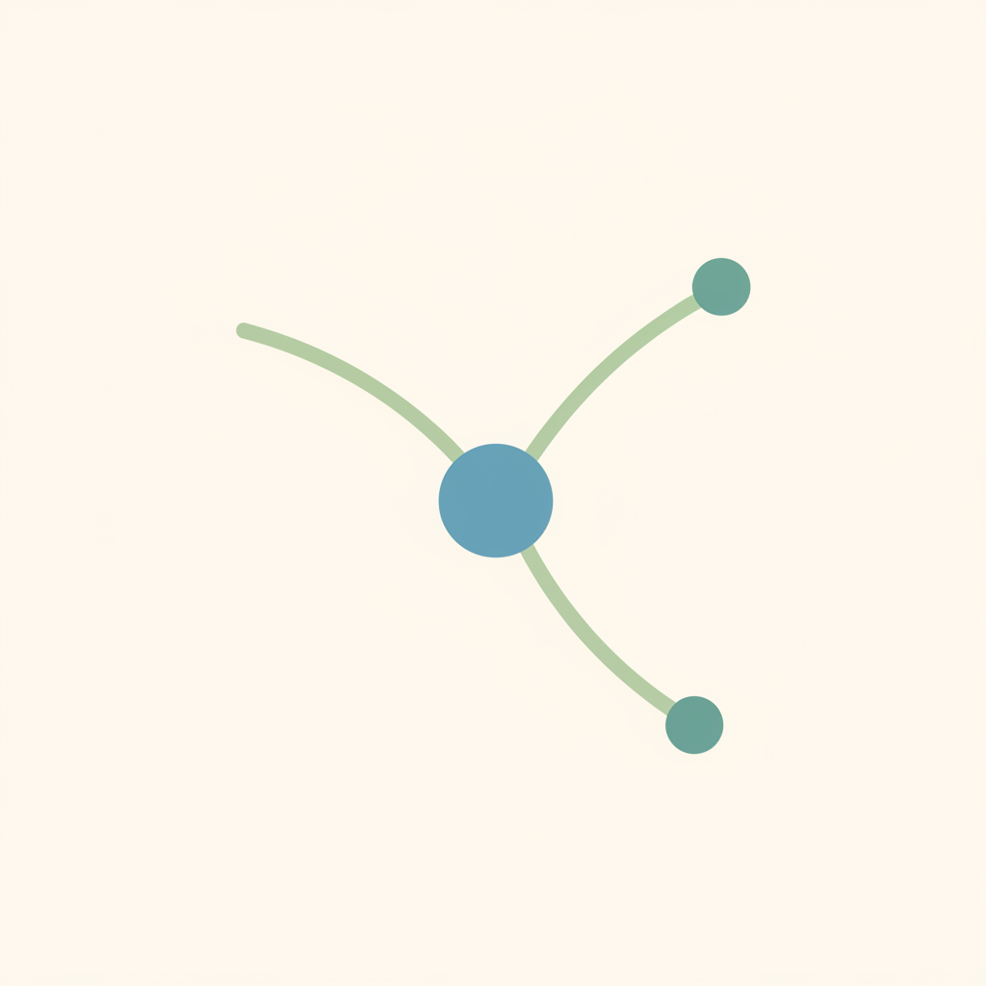
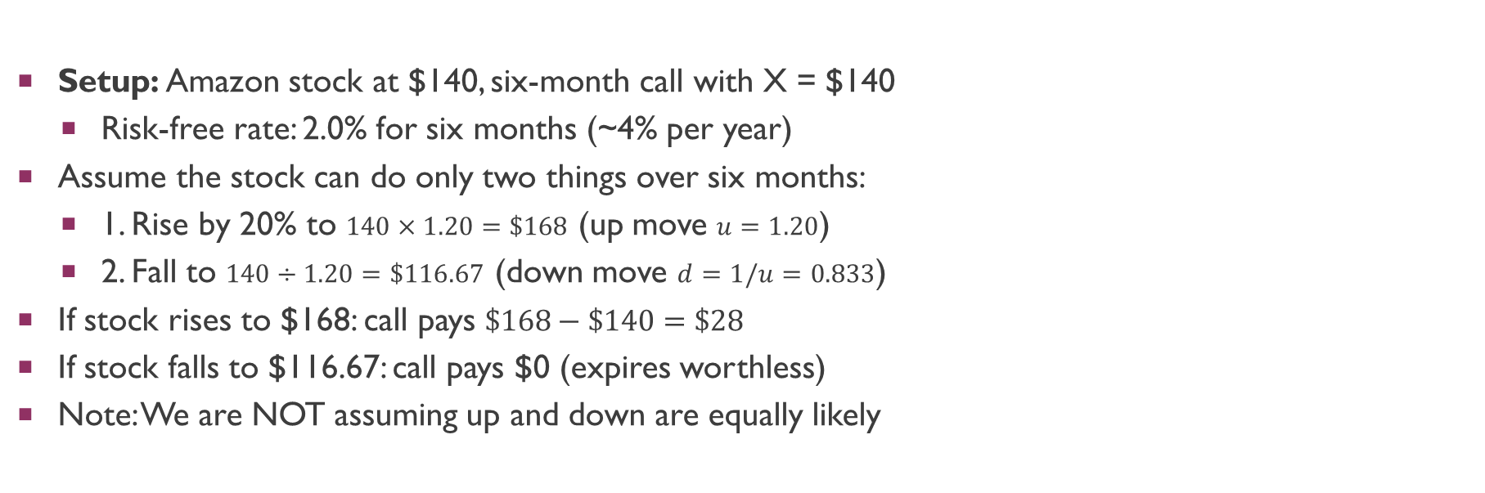
A Simple One-Step Binomial Model
Setup: Amazon stock at $140, six-month call with X = $140
Risk-free rate: 2.0% for six months (~4% per year)
Assume the stock can do only two things over six months:
1. Rise by 20% to $140×1.20=\$168$ (up move $u=1.20$)
2. Fall to $140÷1.20=\$116.67$ (down move $d=1/u=0.833$)
If stock rises to $168: call pays $\$168−\$140=\$28$
If stock falls to $116.67: call pays $0 (expires worthless)
Note: We are NOT assuming up and down are equally likely

Slide 6
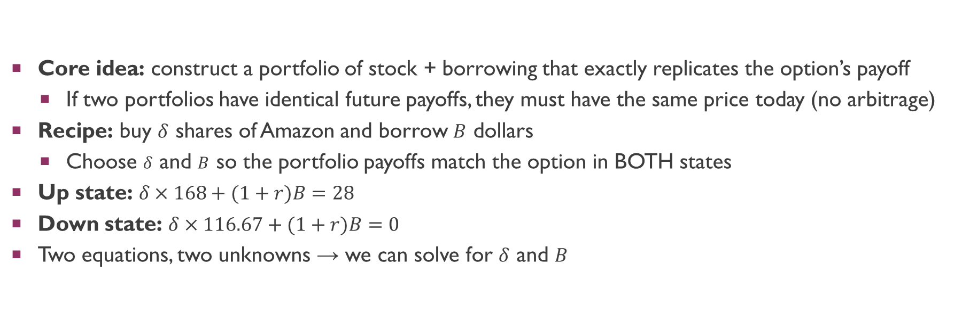
The Replicating Portfolio Approach
Core idea: construct a portfolio of stock + borrowing that exactly replicates the option’s payoff
If two portfolios have identical future payoffs, they must have the same price today (no arbitrage)
Recipe: buy $δ$ shares of Amazon and borrow $B$ dollars
Choose $δ$ and $B$ so the portfolio payoffs match the option in BOTH states
Up state: $δ×168+(1+r)B=28$
Down state: $δ×116.67+(1+r)B=0$
Two equations, two unknowns → we can solve for $δ$ and $B$

Slide 7

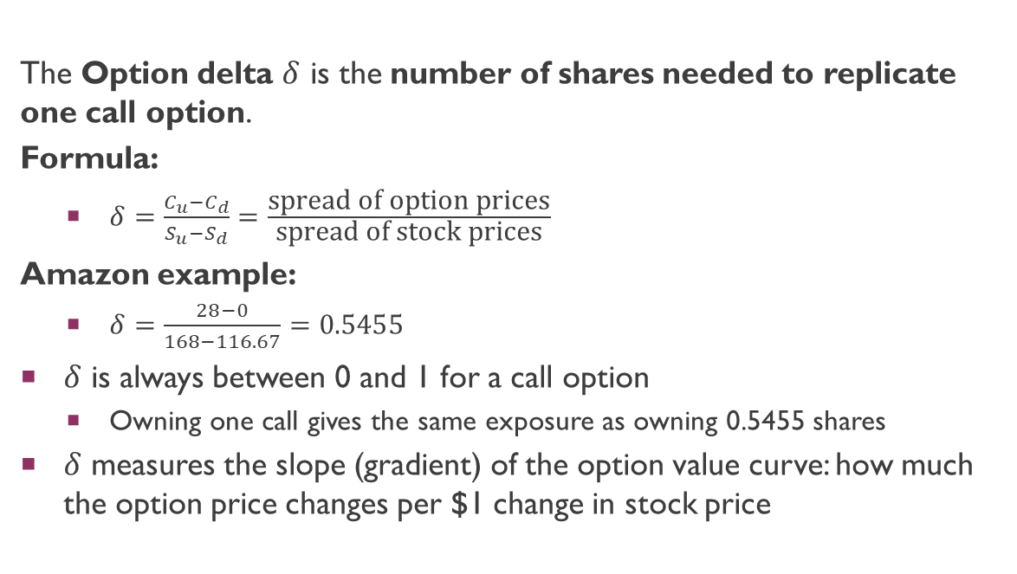
Option Delta (Hedge Ratio)
The Option delta $δ$ is the number of shares needed to replicate one call option.
Formula:
$δ=\frac{C_{u}−C_{d}}{S_{u}−S_{d}}=\frac{\text{spread} \text{of} \text{option} \text{prices}}{\text{spread} \text{of} \text{stock} \text{prices}}$
Amazon example:
$δ=\frac{28−0}{168−116.67}=0.5455$
$δ$ is always between 0 and 1 for a call option
Owning one call gives the same exposure as owning 0.5455 shares
$δ$ measures the slope (gradient) of the option value curve: how much the option price changes per $1 change in stock price

Slide 8
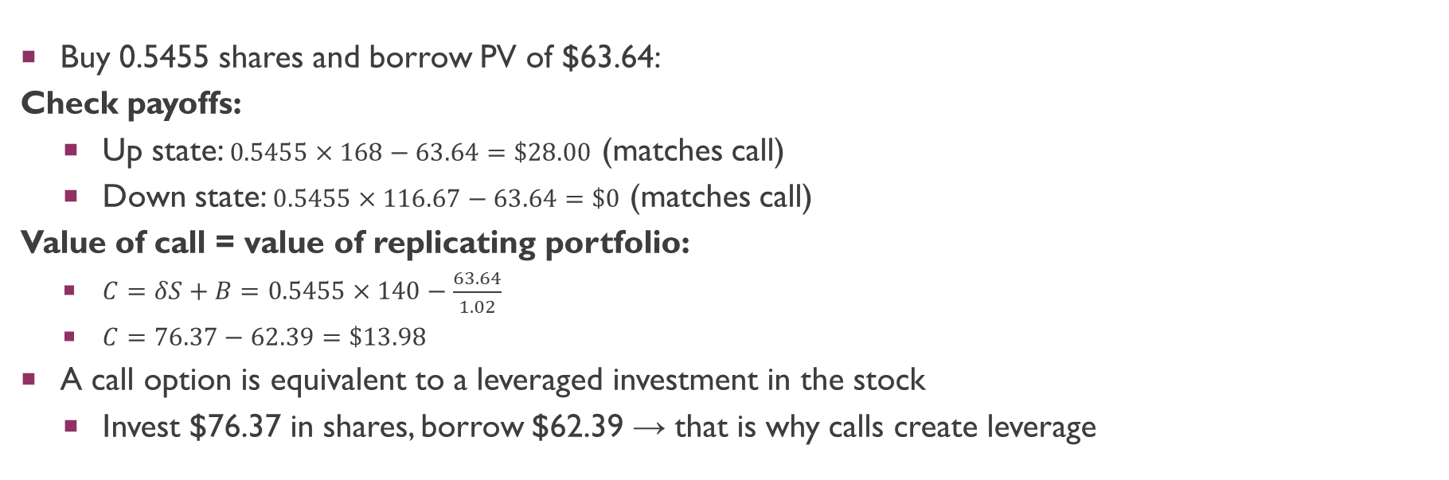
Valuing the Amazon Call: Replicating Portfolio
Buy 0.5455 shares and borrow PV of $63.64:
Check payoffs:
Up state: $0.5455×168−63.64=\$28.00$ (matches call)
Down state: $0.5455×116.67−63.64=\$0$ (matches call)
Value of call = value of replicating portfolio:
$C=δS+B=0.5455×140−\frac{63.64}{1.02}$
$C=76.37−62.39=\$13.98$
A call option is equivalent to a leveraged investment in the stock
Invest $76.37 in shares, borrow $62.39 → that is why calls create leverage

Slide 9
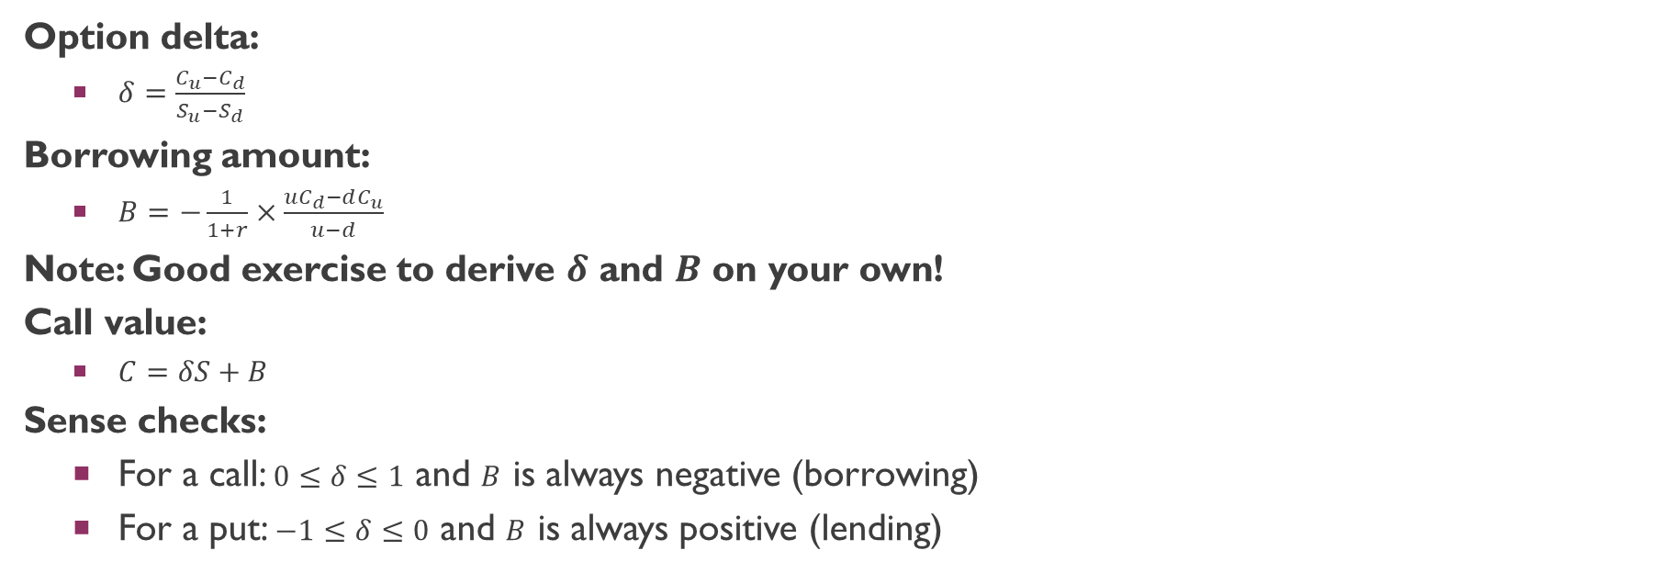
General Formulas for the Replicating Portfolio
Option delta:
$δ=\frac{C_{u}−C_{d}}{S_{u}−S_{d}}$
Borrowing amount:
$B=−\frac{1}{1+r}×\frac{uC_{d}−dC_{u}}{u−d}$
Note: Good exercise to derive $δ$ and $B$ on your own!
Call value:
$C=δS+B$
Sense checks:
For a call: $0≤δ≤1$ and $B$ is always negative (borrowing)
For a put: $−1≤δ≤0$ and $B$ is always positive (lending)

Slide 10

The Risk-Neutral Approach: Intuition
If the option price deviates from $13.98, arbitrage is possible:
If price > $13.98: buy 0.5455 shares, sell the call, borrow → risk-free profit
If price < $13.98: sell 0.5455 shares, buy the call, lend → risk-free profit
Because the arbitrage is risk-free, we never needed to know investors’ risk preferences
Key insight: the option price cannot depend on investors’ attitude to risk
So we may assume any risk preference that is convenient
The most convenient: assume investors are risk-neutral
Then the expected return on every asset equals the risk-free rate

Slide 11
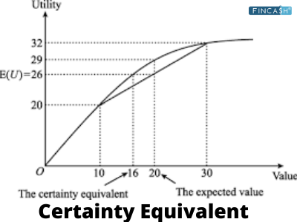
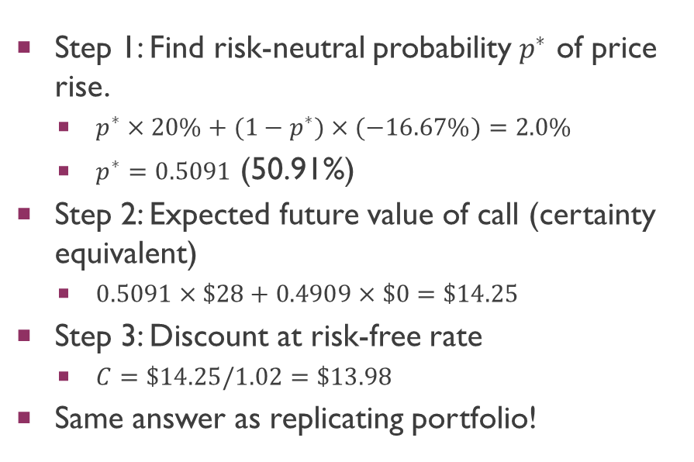
Risk-Neutral Valuation: Three Steps
Step 1: Find risk-neutral probability $p^{∗}$ of price rise.
$p^{∗}×20\%+(1−p^{∗})×(−16.67\%)=2.0\%$
$p^{∗}=0.5091$ (50.91%)
Step 2: Expected future value of call (certainty equivalent)
$0.5091×\$28+0.4909×\$0=\$14.25$
Step 3: Discount at risk-free rate
$C=\$14.25/1.02=\$13.98$
Same answer as replicating portfolio!
Notes:
ER on stock = risk free rate, because we assume investors are RISK NEUTRAL.

Slide 12
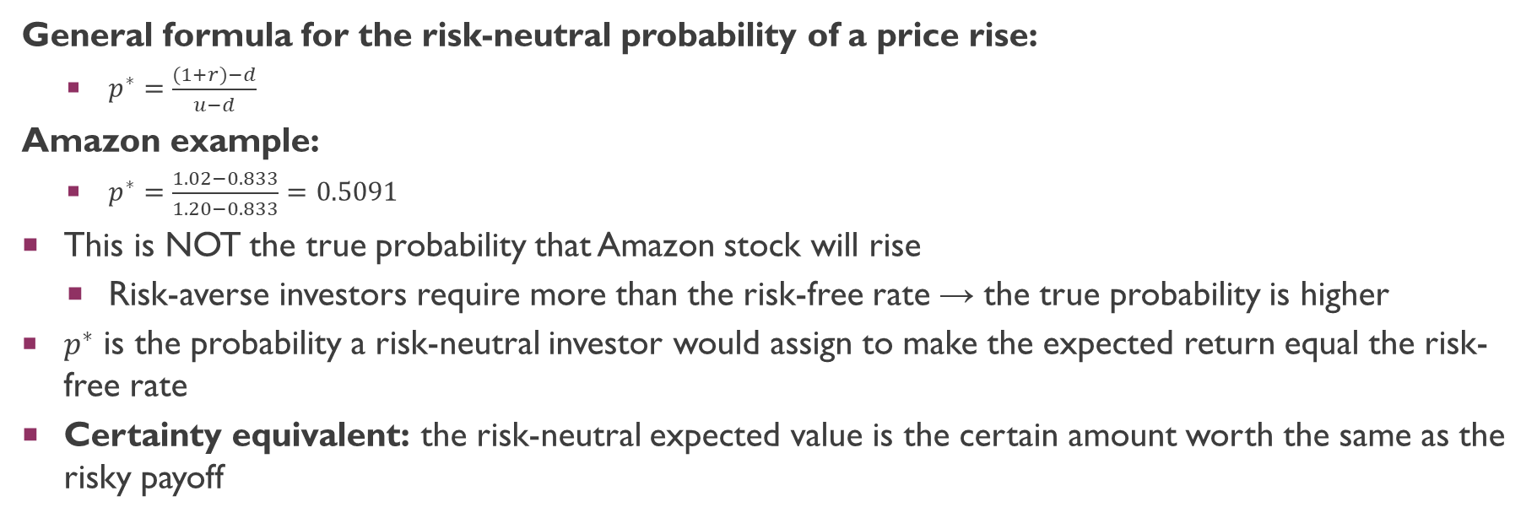
The Risk-Neutral Probability
General formula for the risk-neutral probability of a price rise:
$p^{∗}=\frac{(1+r)−d}{u−d}$
Amazon example:
$p^{∗}=\frac{1.02−0.833}{1.20−0.833}=0.5091$
This is NOT the true probability that Amazon stock will rise
Risk-averse investors require more than the risk-free rate → the true probability is higher
$p^{∗}$ is the probability a risk-neutral investor would assign to make the expected return equal the risk-free rate
Certainty equivalent: the risk-neutral expected value is the certain amount worth the same as the risky payoff

Slide 13
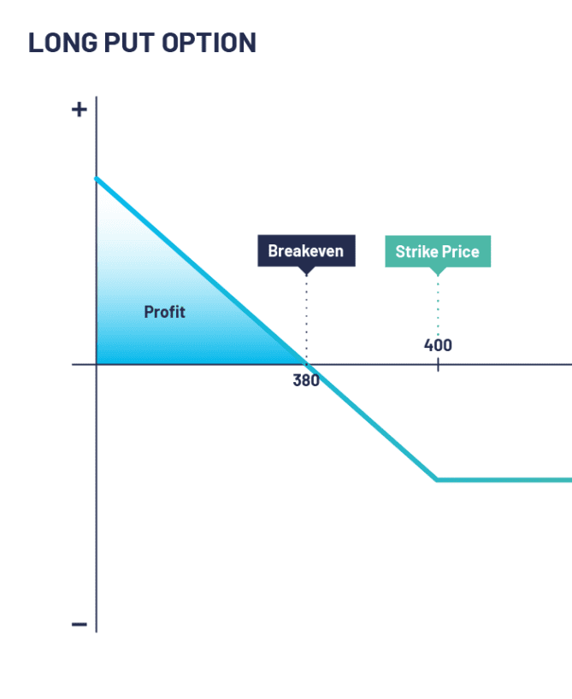
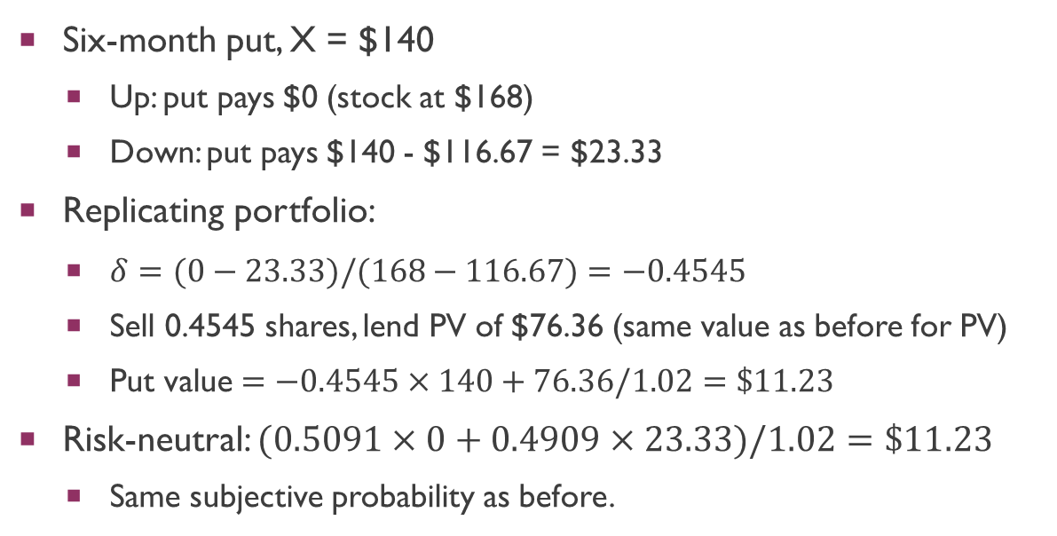
Valuing the Amazon Put Option
Six-month put, X = $140
Up: put pays $0 (stock at $168)
Down: put pays $140 - $116.67 = $23.33
Replicating portfolio:
$δ=(0−23.33)/(168−116.67)=−0.4545$
Sell 0.4545 shares, lend PV of $76.36 (same value as before for PV)
Put value $=−0.4545×140+76.36/1.02=\$11.23$
Risk-neutral: $(0.5091×0+0.4909×23.33)/1.02=\$11.23$
Same subjective probability as before.
Notes:
P* x 0 + (1-p*) x payoff on down state.

Slide 14
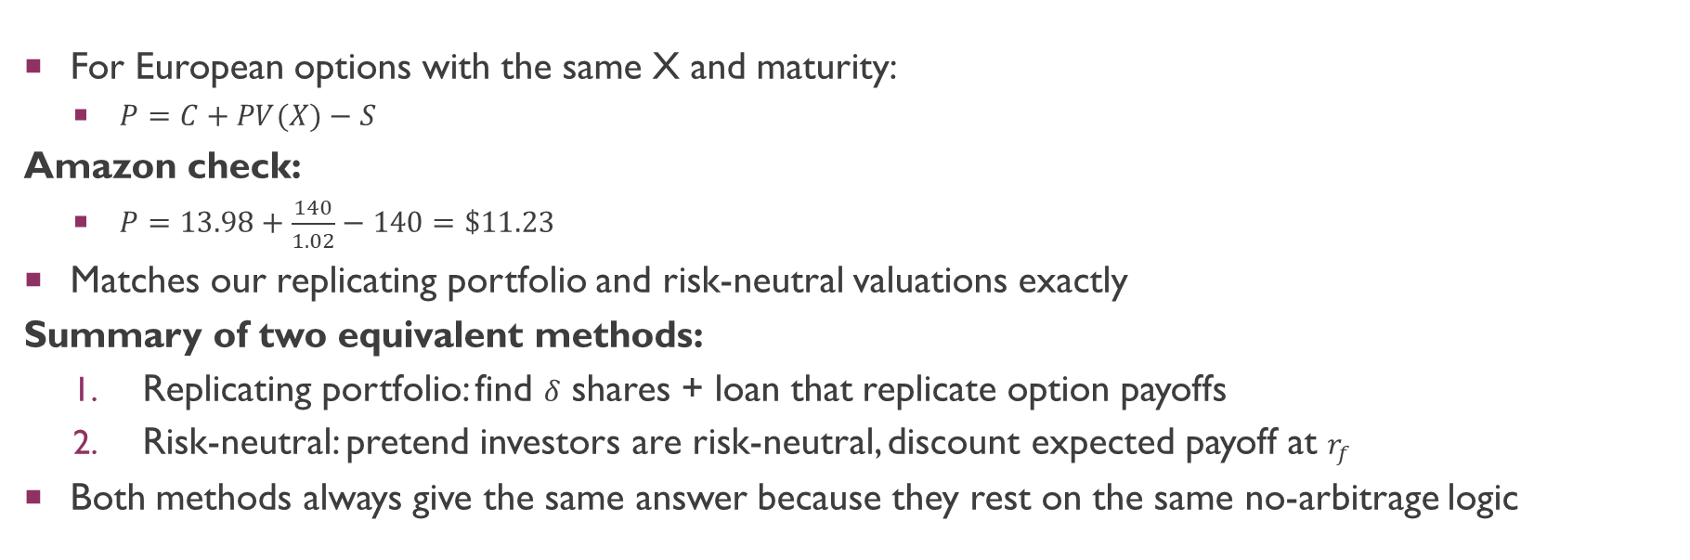
Put-Call Parity: A Consistency Check
For European options with the same X and maturity:
$P=C+PV(X)−S$
Amazon check:
$P=13.98+\frac{140}{1.02}−140=\$11.23$
Matches our replicating portfolio and risk-neutral valuations exactly
Summary of two equivalent methods:
Replicating portfolio: find $δ$ shares + loan that replicate option payoffs
Risk-neutral: pretend investors are risk-neutral, discount expected payoff at $r_{f}$
Both methods always give the same answer because they rest on the same no-arbitrage logic

Slide 15
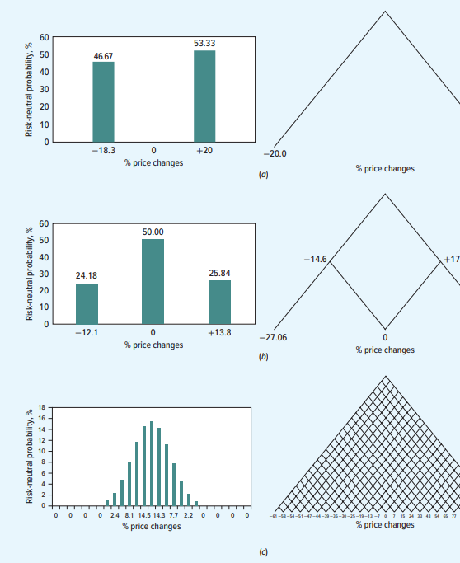
The Binomial Method: Adding Realism
One step: stock takes only 2 values (unrealistic)
Solution: divide option life into many short periods
Each period: stock goes up or down
More periods = wider range of final prices
Two 3-month periods give 3 possible prices at maturity
26 weekly periods give 27 possible prices
As periods increase, distribution approaches lognormal
Work backward through the tree to find today's value

Slide 16
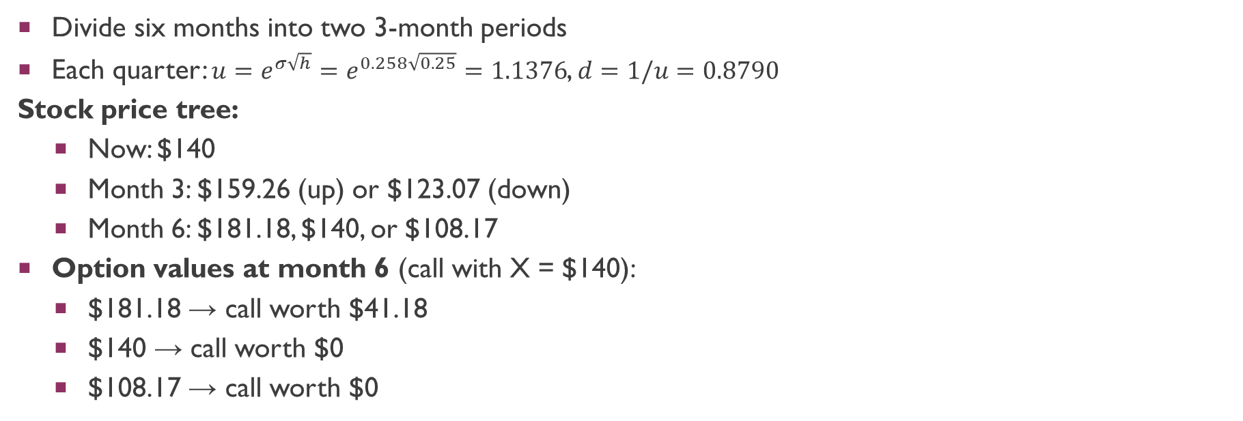
Two-Step Binomial: Amazon Example
Divide six months into two 3-month periods
Each quarter: $u=e^{σ\sqrt{h}}=e^{0.258\sqrt{0.25}}=1.1376$, $d=1/u=0.8790$
Stock price tree:
Now: $140
Month 3: $159.26 (up) or $123.07 (down)
Month 6: $181.18, $140, or $108.17
Option values at month 6 (call with X = $140):
$181.18 → call worth $41.18
$140 → call worth $0
$108.17 → call worth $0

Slide 17
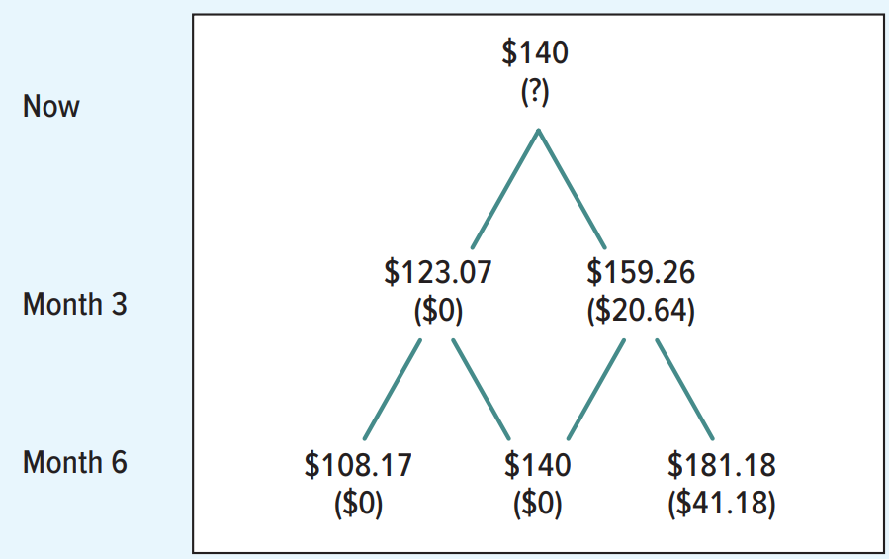
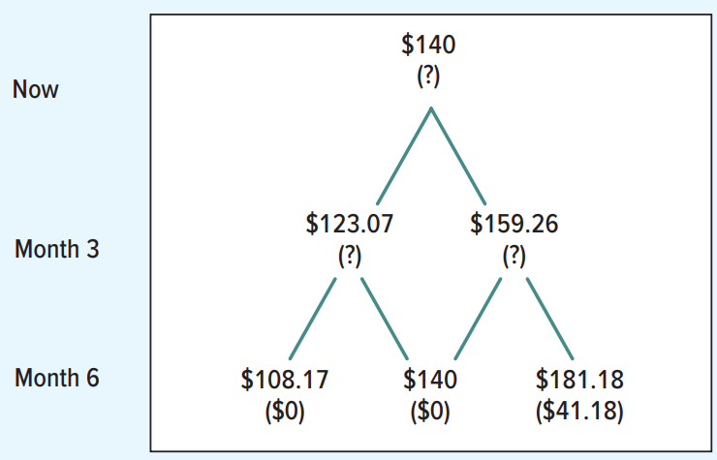
Two-Step Binomial: Amazon Example

Slide 18
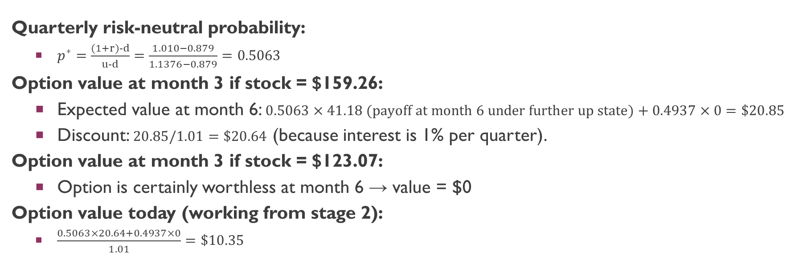
Working Backward Through the Binomial Tree
Quarterly risk-neutral probability:
$p^{∗}=\frac{(1+r)−d}{u−d}=\frac{1.010−0.879}{1.1376−0.879}=0.5063$
Option value at month 3 if stock = $159.26:
Expected value at month 6: $0.5063×41.18 (payoff at month 6 under further up state)+0.4937×0=\$20.85$
Discount: $20.85/1.01=\$20.64$ (because interest is 1% per quarter).
Option value at month 3 if stock = $123.07:
Option is certainly worthless at month 6 → value = $0
Option value today (working from stage 2):
$\frac{0.5063×20.64+0.4937×0}{1.01}=\$10.35$

Slide 19
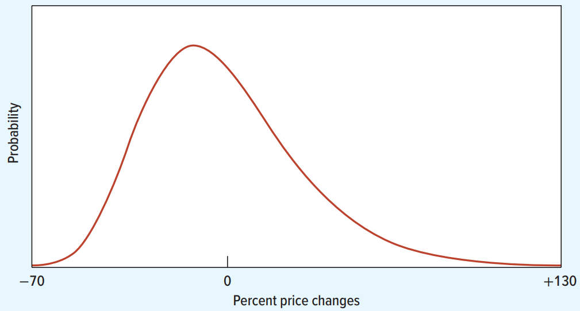
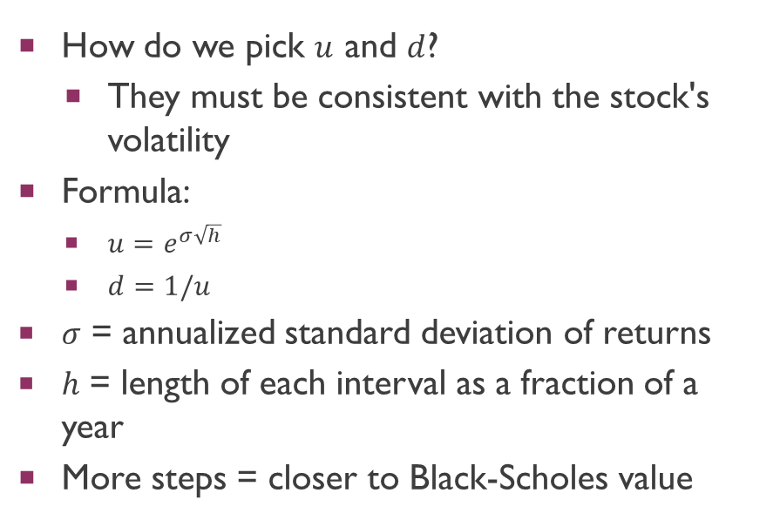
Calibrating the Up and Down Moves
How do we pick $u$ and $d$?
They must be consistent with the stock's volatility
Formula:
$u=e^{σ\sqrt{h}}$
$d=1/u$
$σ$ = annualized standard deviation of returns
$h$ = length of each interval as a fraction of a year
More steps = closer to Black-Scholes value

Slide 20
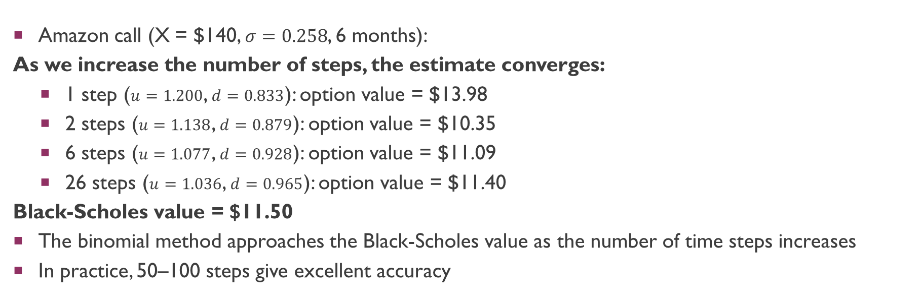
Binomial Method: Convergence to Black-Scholes
Amazon call (X = $140, $σ=0.258$, 6 months):
As we increase the number of steps, the estimate converges:
1 step ($u=1.200$, $d=0.833$): option value = $13.98
2 steps ($u=1.138$, $d=0.879$): option value = $10.35
6 steps ($u=1.077$, $d=0.928$): option value = $11.09
26 steps ($u=1.036$, $d=0.965$): option value = $11.40
Black-Scholes value = $11.50
The binomial method approaches the Black-Scholes value as the number of time steps increases
In practice, 50–100 steps give excellent accuracy

Slide 21
American Options and the Binomial Method
European options: can only exercise at maturity
American options: can exercise at any time before maturity
American calls on non-dividend-paying stocks:
Never optimal to exercise early (see bullet point below) → value = European call → use Black-Scholes
Early exercise throws away time value and the interest saved by delaying payment of X
American puts:
Can be optimal to exercise early (e.g., if stock price drops to zero)
Exercise immediately and reinvest the exercise price at the risk-free rate
To value American options, use the binomial method and check at each node whether exercising early gives higher value

Slide 22

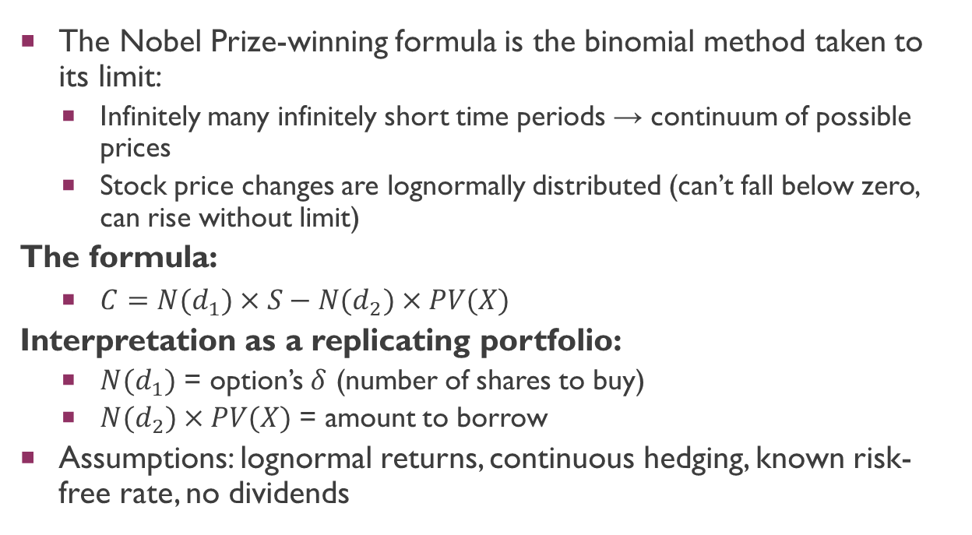
The Black-Scholes Formula
The Nobel Prize-winning formula is the binomial method taken to its limit:
Infinitely many infinitely short time periods → continuum of possible prices
Stock price changes are lognormally distributed (can’t fall below zero, can rise without limit)
The formula:
$C=N(d_{1})×S−N(d_{2})×PV(X)$
Interpretation as a replicating portfolio:
$N(d_{1})$ = option’s $δ$ (number of shares to buy)
$N(d_{2})×PV(X)$ = amount to borrow
Assumptions: lognormal returns, continuous hedging, known risk-free rate, no dividends

Slide 23
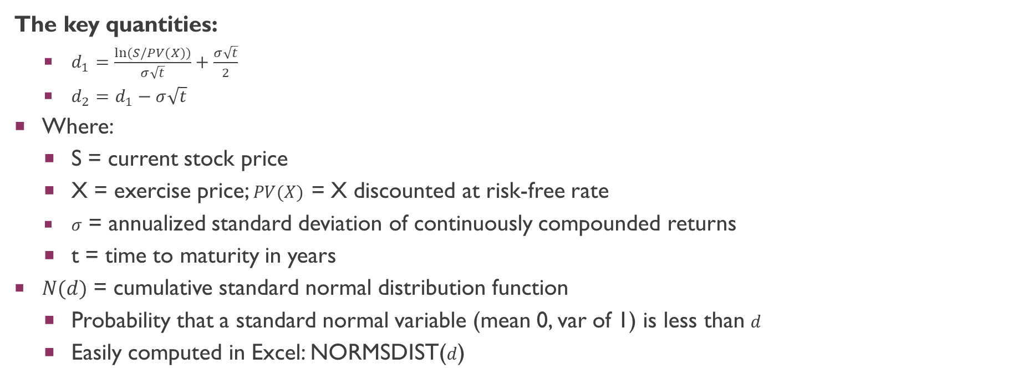

Black-Scholes: Computing $d_{1}$ and $d_{2}$
The key quantities:
$d_{1}=\frac{ln(S/PV(X))}{σ\sqrt{t}}+\frac{σ\sqrt{t}}{2}$
$d_{2}=d_{1}−σ\sqrt{t}$
Where:
S = current stock price
X = exercise price; $PV(X)$ = X discounted at risk-free rate
$σ$ = annualized standard deviation of continuously compounded returns
t = time to maturity in years
$N(d)$ = cumulative standard normal distribution function
Probability that a standard normal variable (mean 0, var of 1) is less than $d$
Easily computed in Excel: NORMSDIST($d$)

Slide 24
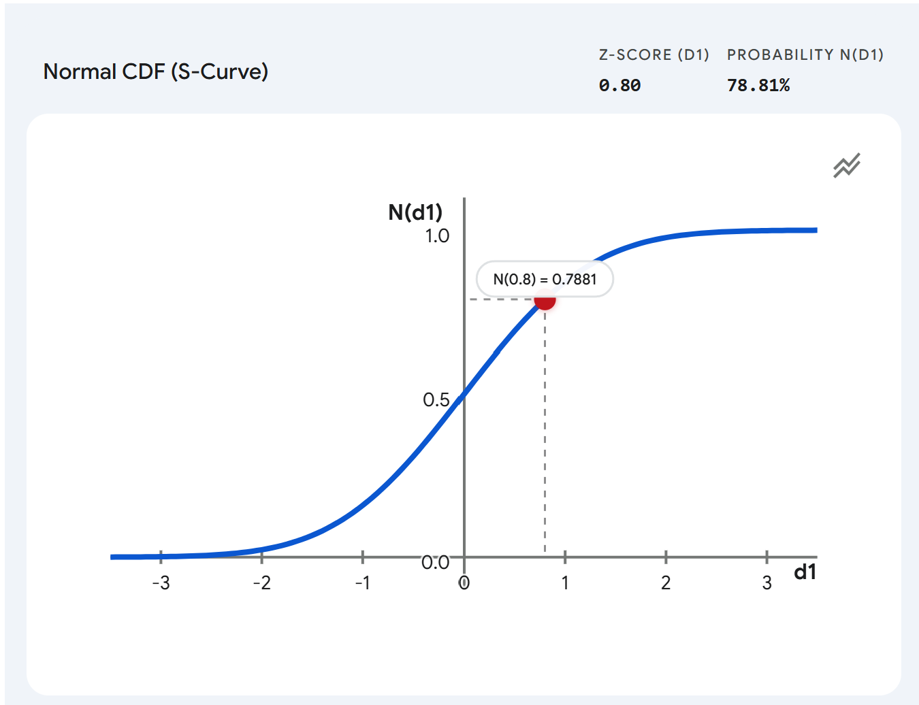
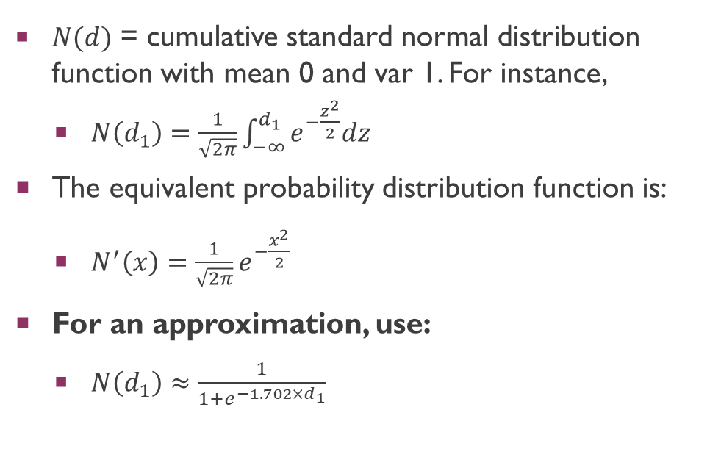
Black-Scholes: Computing $d_{1}$ and $d_{2}$
$N(d)$ = cumulative standard normal distribution function with mean 0 and var 1. For instance,
$N\left(d_{1}\right)=\frac{1}{\sqrt{2π}}\int_{−∞}^{d_{1}}{e^{−\frac{z^{2}}{2}}dz}$
The equivalent probability distribution function is:
$N^{′}\left(x\right)=\frac{1}{\sqrt{2π}}e^{−\frac{x^{2}}{2}}$
For an approximation, use:
$N\left(d_{1}\right)≈\frac{1}{1+e^{−1.702×d_{1}}}$

Slide 25
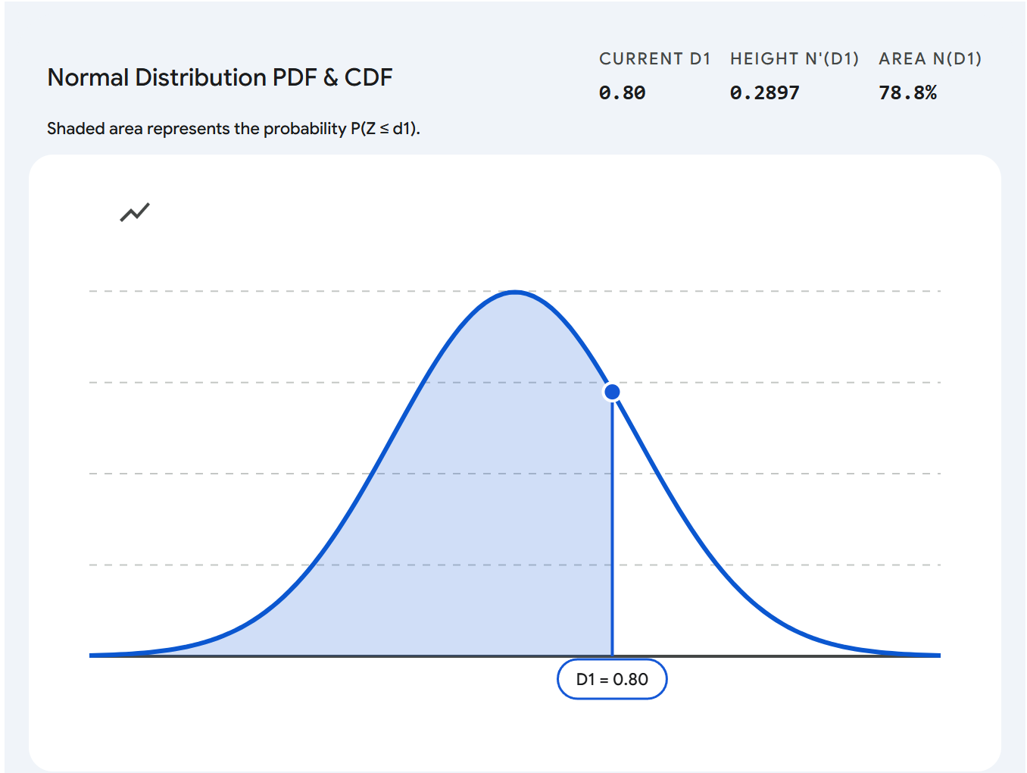
Black-Scholes: Computing $d_{1}$ and $d_{2}$

Slide 26
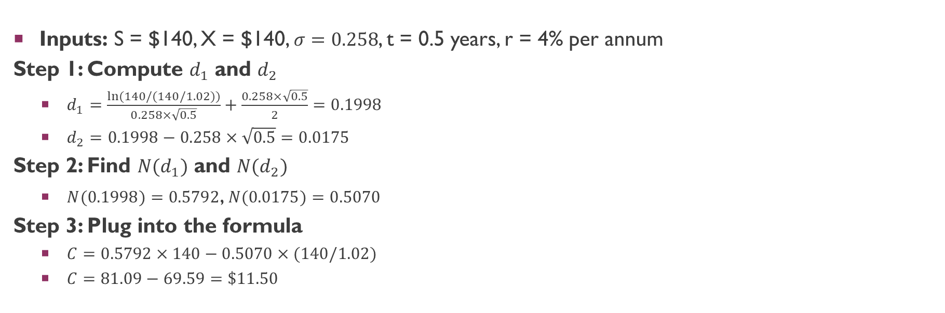
Black-Scholes: Amazon Call Worked Example
Inputs: S = $140, X = $140, $σ=0.258$, t = 0.5 years, r = 4% per annum
Step 1: Compute $d_{1}$ and $d_{2}$
$d_{1}=\frac{ln(140/(140/1.02))}{0.258×\sqrt{0.5}}+\frac{0.258×\sqrt{0.5}}{2}=0.1998$
$d_{2}=0.1998−0.258×\sqrt{0.5}=0.0175$
Step 2: Find $N(d_{1})$ and $N(d_{2})$
$N(0.1998)=0.5792$, $N(0.0175)=0.5070$
Step 3: Plug into the formula
$C=0.5792×140−0.5070×(140/1.02)$
$C=81.09−69.59=\$11.50$

Slide 27
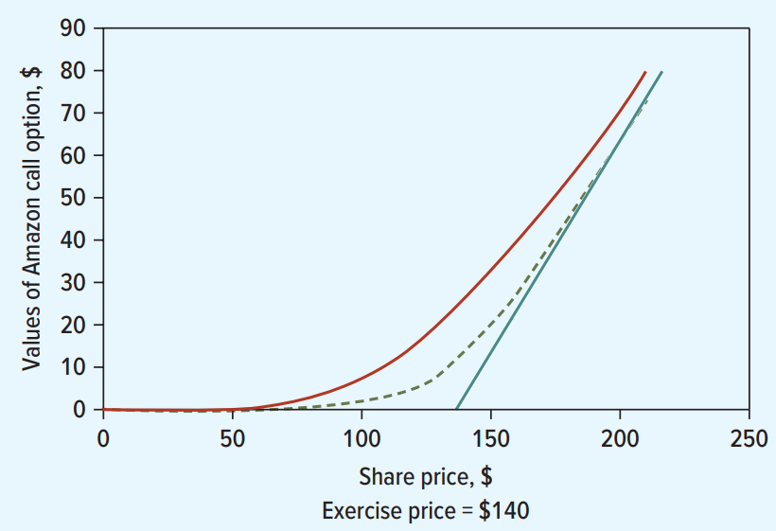
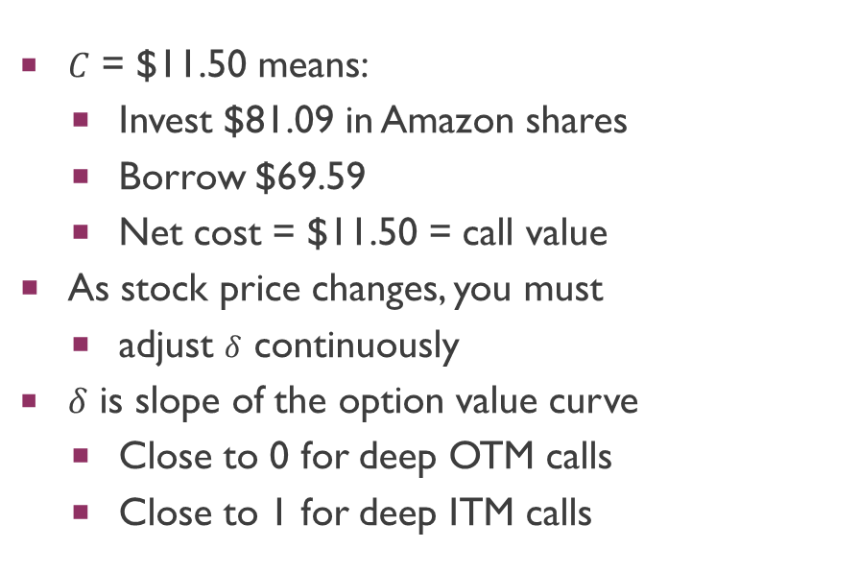
Black-Scholes as a Replicating Portfolio
$C$ = $11.50 means:
Invest $81.09 in Amazon shares
Borrow $69.59
Net cost = $11.50 = call value
As stock price changes, you must
adjust $δ$ continuously
$δ$ is slope of the option value curve
Close to 0 for deep OTM calls
Close to 1 for deep ITM calls

Slide 28
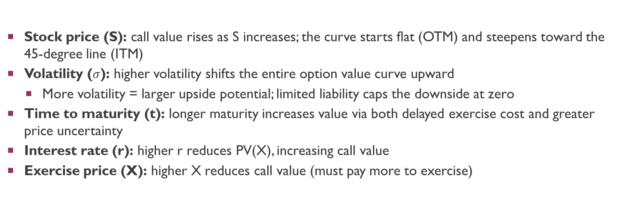
How Option Values Change with Inputs
Stock price (S): call value rises as S increases; the curve starts flat (OTM) and steepens toward the 45-degree line (ITM)
Volatility ($σ$): higher volatility shifts the entire option value curve upward
More volatility = larger upside potential; limited liability caps the downside at zero
Time to maturity (t): longer maturity increases value via both delayed exercise cost and greater price uncertainty
Interest rate (r): higher r reduces PV(X), increasing call value
Exercise price (X): higher X reduces call value (must pay more to exercise)

Slide 29

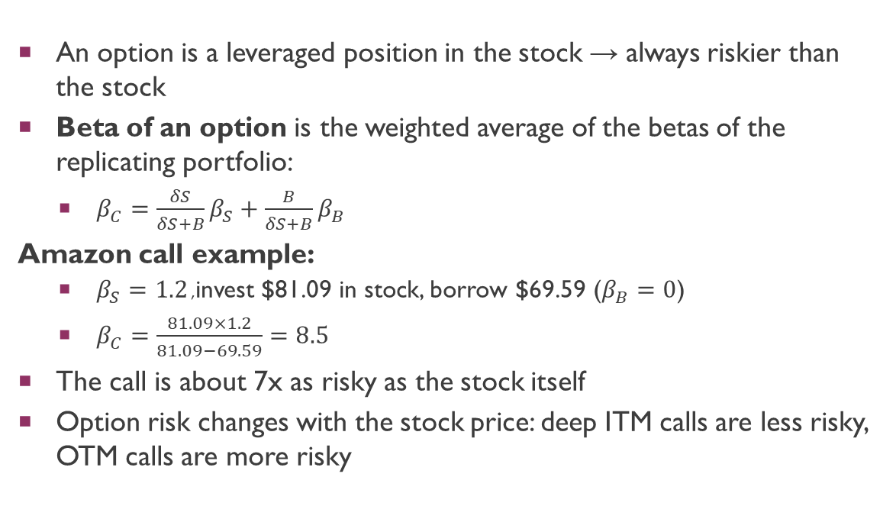
The Risk of an Option
An option is a leveraged position in the stock → always riskier than the stock
Beta of an option is the weighted average of the betas of the replicating portfolio:
$β_{C}=\frac{δS}{δS+B}β_{S}+\frac{B}{δS+B}β_{B}$
Amazon call example:
$β_{S}=1.2$, invest $81.09 in stock, borrow $69.59 ($β_{B}=0$)
$β_{C}=\frac{81.09×1.2}{81.09−69.59}=8.5$
The call is about 7x as risky as the stock itself
Option risk changes with the stock price: deep ITM calls are less risky, OTM calls are more risky

Slide 30
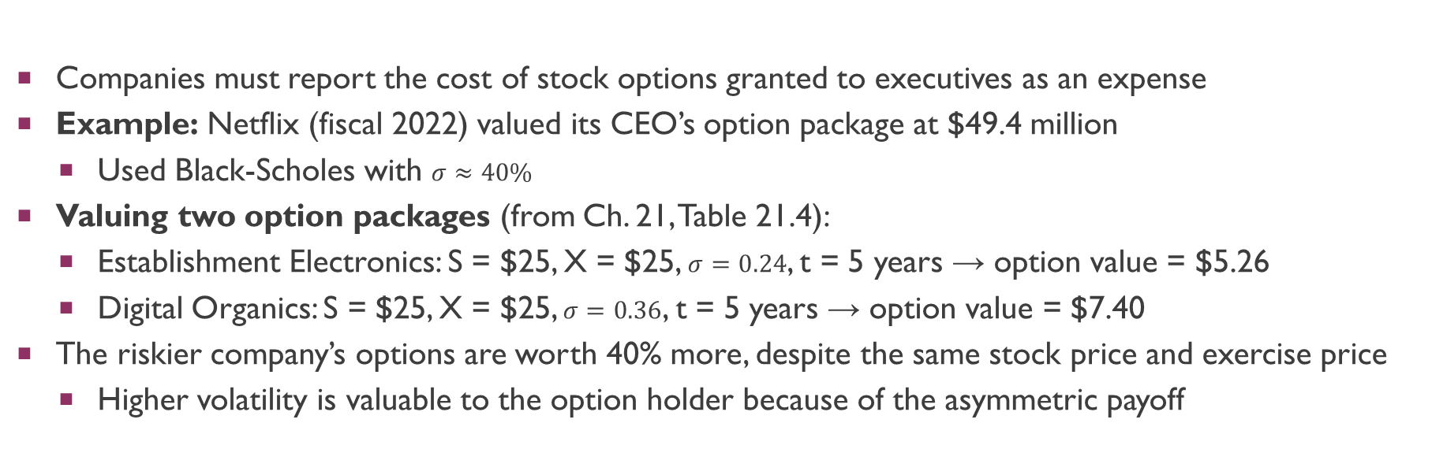
Application 1: Executive Stock Options
Companies must report the cost of stock options granted to executives as an expense
Example: Netflix (fiscal 2022) valued its CEO’s option package at $49.4 million
Used Black-Scholes with $σ≈40\%$
Valuing two option packages (from Ch. 21, Table 21.4):
Establishment Electronics: S = $25, X = $25, $σ=0.24$, t = 5 years → option value = $5.26
Digital Organics: S = $25, X = $25, $σ=0.36$, t = 5 years → option value = $7.40
The riskier company’s options are worth 40% more, despite the same stock price and exercise price
Higher volatility is valuable to the option holder because of the asymmetric payoff

Slide 31
Applications: Warrants and Portfolio Insurance
Warrants are call options issued by the firm itself
Owens Corning (2006): issued 7-year warrants with X = $45.25 on a $30 stock
Stock needed to appreciate 50% before warrants would pay off
Warrants traded at $6 each — valued using Black-Scholes
Portfolio insurance is a put option on a portfolio
Pension fund with $800M portfolio worries about a 20% decline
Bank sells a 1-year put on the market index with X at 80% of current level
Black-Scholes gives the fair price for this insurance
In both cases, Black-Scholes provides the standard valuation tool

Slide 32

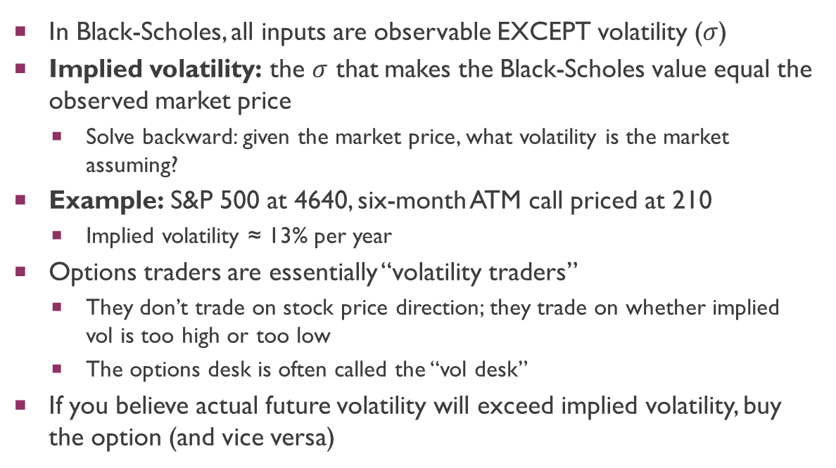
Implied Volatility
In Black-Scholes, all inputs are observable EXCEPT volatility ($σ$)
Implied volatility: the $σ$ that makes the Black-Scholes value equal the observed market price
Solve backward: given the market price, what volatility is the market assuming?
Example: S&P 500 at 4640, six-month ATM call priced at 210
Implied volatility ≈ 13% per year
Options traders are essentially “volatility traders”
They don’t trade on stock price direction; they trade on whether implied vol is too high or too low
The options desk is often called the “vol desk”
If you believe actual future volatility will exceed implied volatility, buy the option (and vice versa)

Slide 33
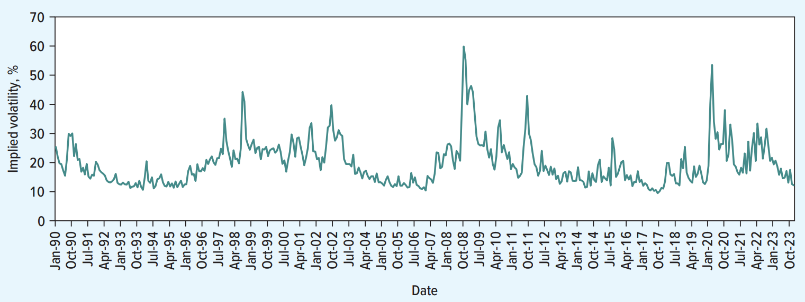
The VIX: The Fear Index
VIX = implied volatility from S&P 500 options
Published by the CBOE since 1986
Average VIX (1990-2023): 19.7%
Spikes during crises:
Black Monday (1987): VIX hit 150
2008 financial crisis: major spike
COVID-19 (Mar 2020): VIX reached 85%
Active trading: >100,000 VIX contracts/day
Buy VIX when you expect volatility to rise

Slide 34
Dividends and Option Valuation
The option holder does NOT receive dividends paid on the underlying stock
European calls and puts on dividend-paying stocks:
Reduce the stock price S by the PV of dividends paid before maturity
Then apply Black-Scholes with the adjusted stock price
Example: if a stock pays a $2 dividend in 3 months and S = $50
Adjusted S = $50 – PV($2) ≈ $48.05 (discounting at the risk-free rate)
Same logic applies to other income the option holder misses:
Foreign currency options: deduct PV of foreign interest earned
Commodity options: deduct PV of convenience yield

Slide 35
American Calls on Dividend-Paying Stocks
Without dividends: never exercise a call early (you throw away time value)
American call = European call → Black-Scholes works directly
With dividends: early exercise CAN be optimal
By exercising just before the ex-dividend date, you capture the dividend
Worth doing if the dividend exceeds the interest saved by delaying exercise
Decision rule at each ex-dividend date:
Exercise early if: dividend > interest on X over the remaining life
Otherwise, hold the option
Use the binomial method: check at each step whether the option is worth more dead (exercised) than alive (held)

Slide 36
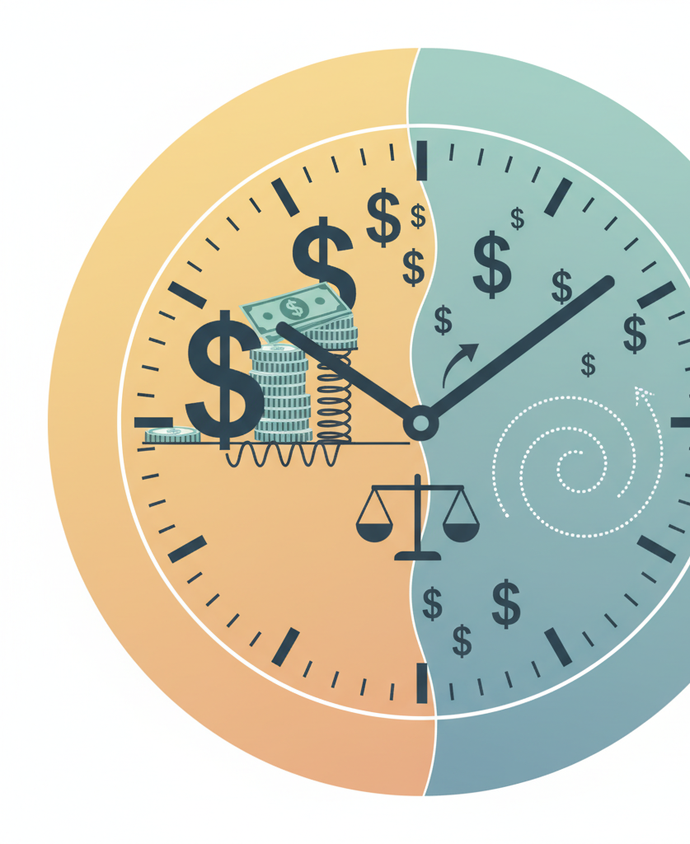
American Puts and Early Exercise
It can be optimal to exercise an American put before maturity
Extreme case: stock price falls to zero
Put is maximally in-the-money; it cannot become more valuable
Exercise immediately and invest the exercise price at the risk-free rate
General rule: exercise when the stock is sufficiently below X that the interest earned on X exceeds the time value sacrificed
An American put is always worth at least as much as a European put
Black-Scholes undervalues American puts (it assumes no early exercise)
The binomial method can properly handle early exercise by checking at each node

Slide 37
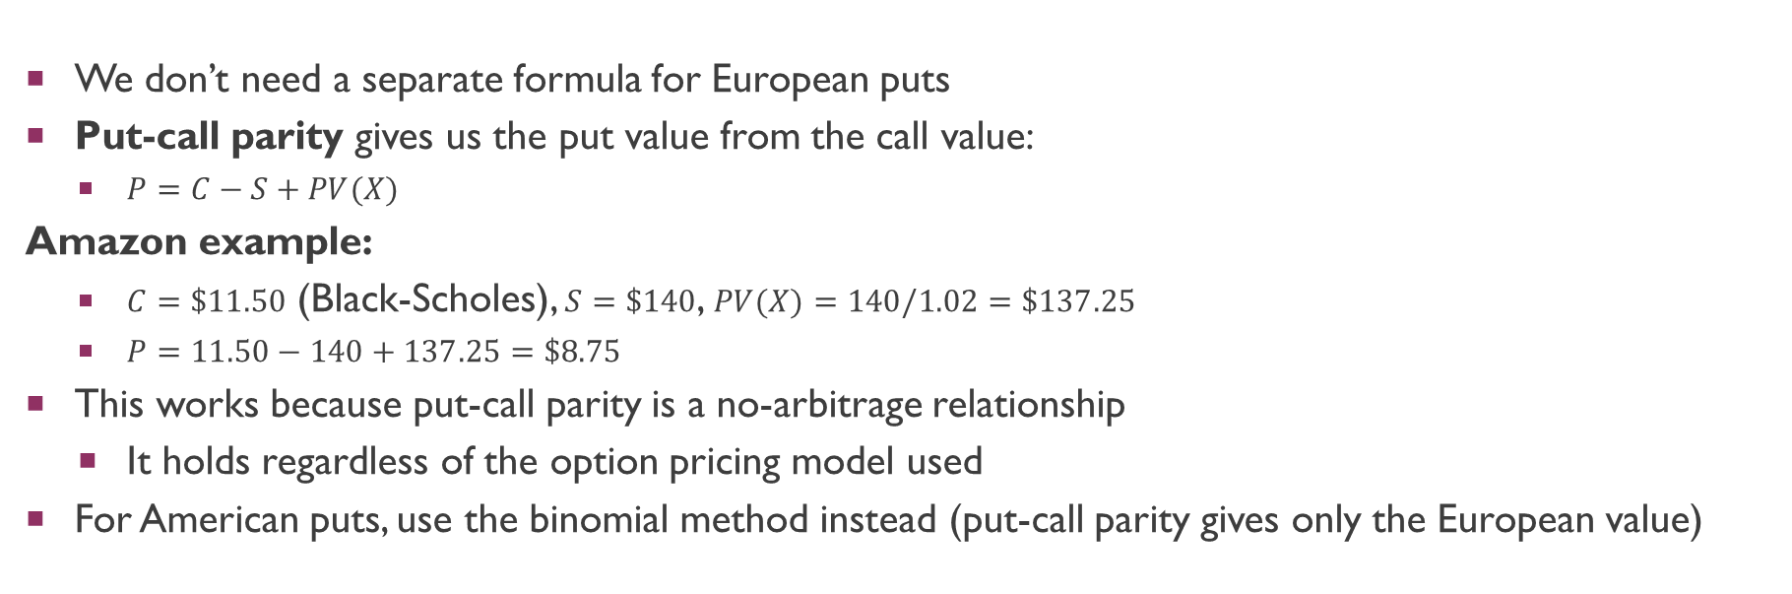
Valuing European Puts via Put-Call Parity
We don’t need a separate formula for European puts
Put-call parity gives us the put value from the call value:
$P=C−S+PV(X)$
Amazon example:
$C=\$11.50$ (Black-Scholes), $S=\$140$, $PV(X)=140/1.02=\$137.25$
$P=11.50−140+137.25=\$8.75$
This works because put-call parity is a no-arbitrage relationship
It holds regardless of the option pricing model used
For American puts, use the binomial method instead (put-call parity gives only the European value)

Slide 38
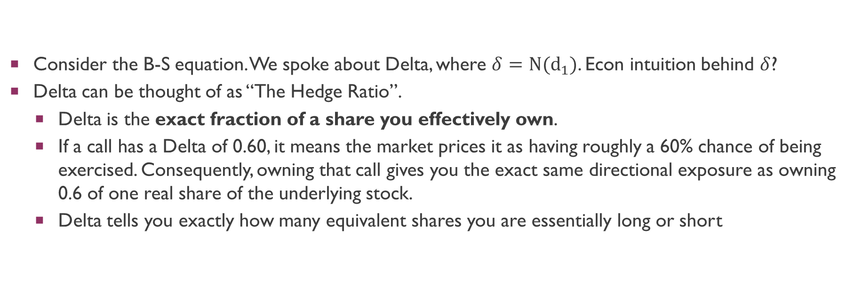
The greeks
Consider the B-S equation. We spoke about Delta, where $δ=N(d_{1})$. Econ intuition behind $δ$?
Delta can be thought of as “The Hedge Ratio”.
Delta is the exact fraction of a share you effectively own.
If a call has a Delta of 0.60, it means the market prices it as having roughly a 60% chance of being exercised. Consequently, owning that call gives you the exact same directional exposure as owning 0.6 of one real share of the underlying stock.
Delta tells you exactly how many equivalent shares you are essentially long or short

Slide 39
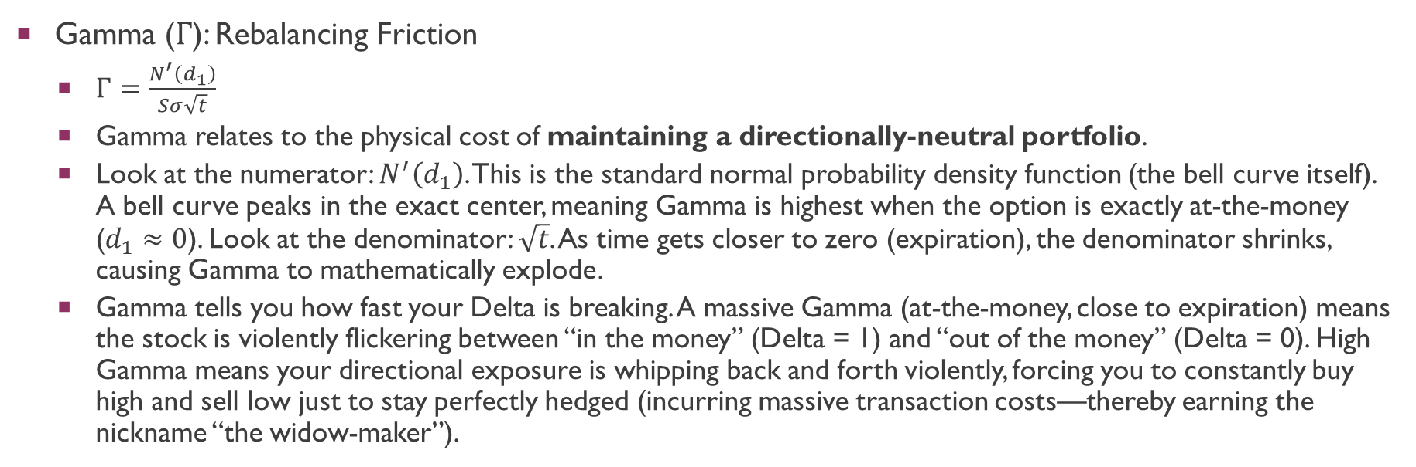
The greeks
Gamma ($Γ$): Rebalancing Friction
$Γ=\frac{N^{′}\left(d_{1}\right)}{Sσ\sqrt{t}}$
Gamma relates to the physical cost of maintaining a directionally-neutral portfolio.
Look at the numerator: $N^{′}\left(d_{1}\right)$. This is the standard normal probability density function (the bell curve itself). A bell curve peaks in the exact center, meaning Gamma is highest when the option is exactly at-the-money ($d_{1}≈0$). Look at the denominator: $\sqrt{t}$. As time gets closer to zero (expiration), the denominator shrinks, causing Gamma to mathematically explode.
Gamma tells you how fast your Delta is breaking. A massive Gamma (at-the-money, close to expiration) means the stock is violently flickering between “in the money” (Delta = 1) and “out of the money” (Delta = 0). High Gamma means your directional exposure is whipping back and forth violently, forcing you to constantly buy high and sell low just to stay perfectly hedged (incurring massive transaction costs—thereby earning the nickname “the widow-maker”).
Notes:
Directionally-neutral (trying to make sure the portfolio value doesn’t go UP or DOWN.

Slide 40
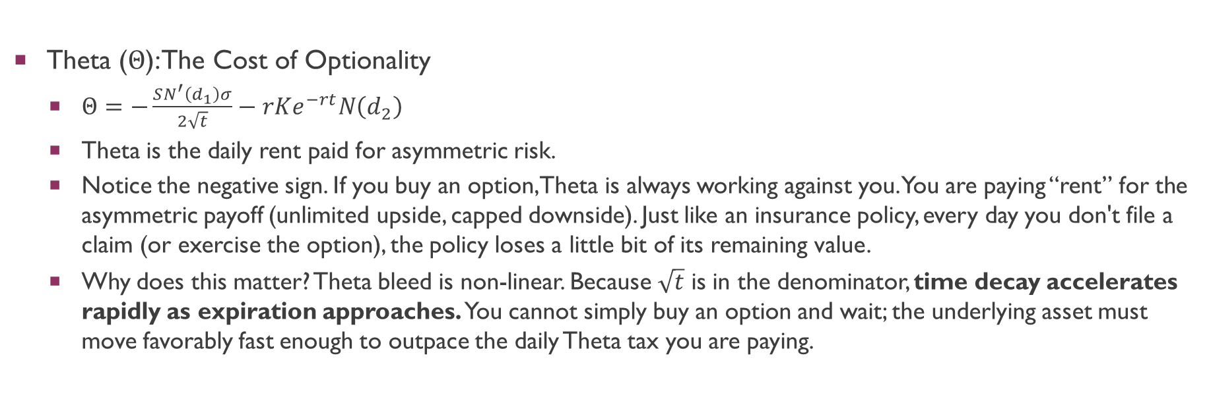
The greeks
Theta ($Θ$): The Cost of Optionality
$Θ=−\frac{SN^{′}\left(d_{1}\right)σ}{2\sqrt{t}}−rKe^{−rt}N\left(d_{2}\right)$
Theta is the daily rent paid for asymmetric risk.
Notice the negative sign. If you buy an option, Theta is always working against you. You are paying “rent” for the asymmetric payoff (unlimited upside, capped downside). Just like an insurance policy, every day you don't file a claim (or exercise the option), the policy loses a little bit of its remaining value.
Why does this matter? Theta bleed is non-linear. Because $\sqrt{t}$ is in the denominator, time decay accelerates rapidly as expiration approaches. You cannot simply buy an option and wait; the underlying asset must move favorably fast enough to outpace the daily Theta tax you are paying.

Slide 41
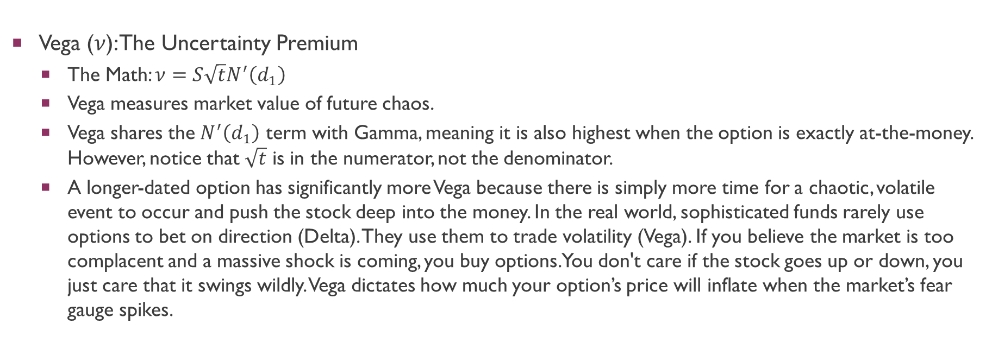
The greeks
Vega ($ν$): The Uncertainty Premium
The Math: $ν=S\sqrt{t}N^{′}\left(d_{1}\right)$
Vega measures market value of future chaos.
Vega shares the $N^{′}\left(d_{1}\right)$ term with Gamma, meaning it is also highest when the option is exactly at-the-money. However, notice that $\sqrt{t}$ is in the numerator, not the denominator.
A longer-dated option has significantly more Vega because there is simply more time for a chaotic, volatile event to occur and push the stock deep into the money. In the real world, sophisticated funds rarely use options to bet on direction (Delta). They use them to trade volatility (Vega). If you believe the market is too complacent and a massive shock is coming, you buy options. You don't care if the stock goes up or down, you just care that it swings wildly. Vega dictates how much your option’s price will inflate when the market’s fear gauge spikes.

Slide 42
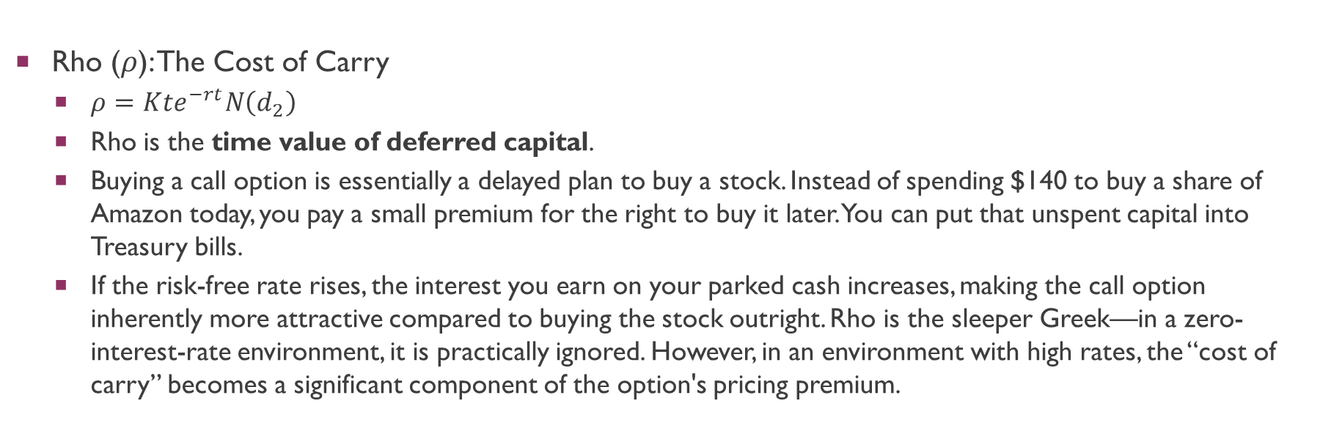
The greeks
Rho ($ρ$): The Cost of Carry
$ρ=Kte^{−rt}N\left(d_{2}\right)$
Rho is the time value of deferred capital.
Buying a call option is essentially a delayed plan to buy a stock. Instead of spending $140 to buy a share of Amazon today, you pay a small premium for the right to buy it later. You can put that unspent capital into Treasury bills.
If the risk-free rate rises, the interest you earn on your parked cash increases, making the call option inherently more attractive compared to buying the stock outright. Rho is the sleeper Greek—in a zero-interest-rate environment, it is practically ignored. However, in an environment with high rates, the “cost of carry” becomes a significant component of the option's pricing premium.

Slide 43
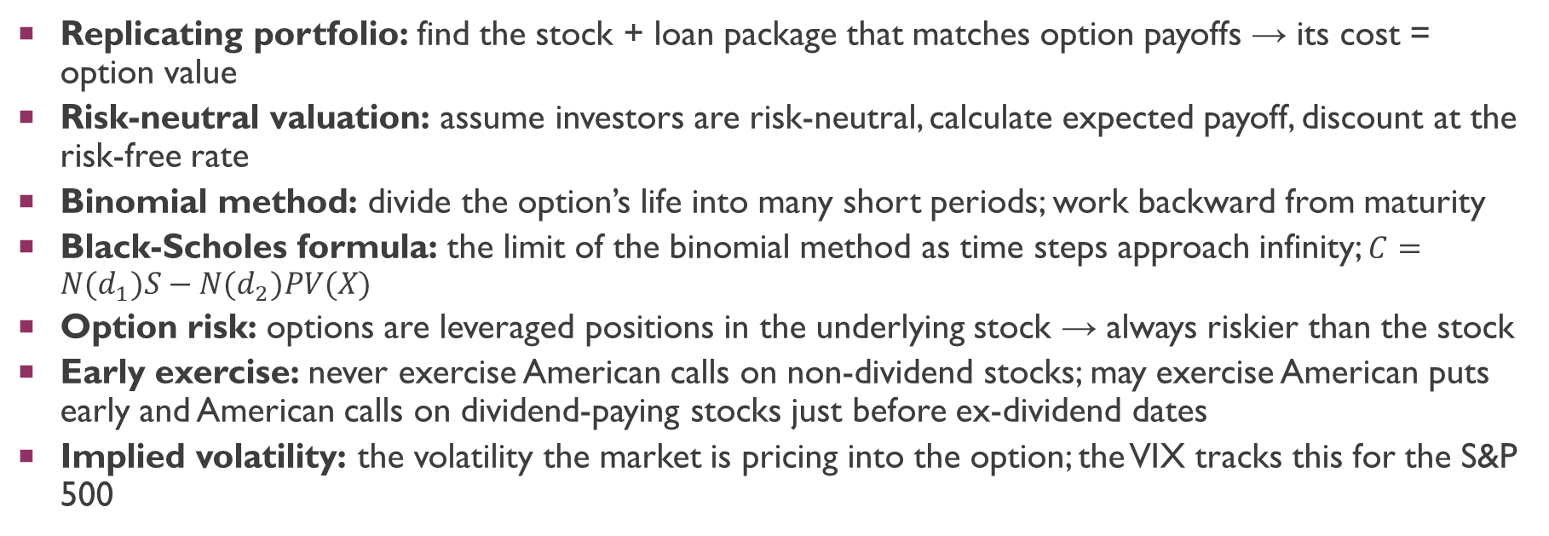
Key Takeaways
Replicating portfolio: find the stock + loan package that matches option payoffs → its cost = option value
Risk-neutral valuation: assume investors are risk-neutral, calculate expected payoff, discount at the risk-free rate
Binomial method: divide the option’s life into many short periods; work backward from maturity
Black-Scholes formula: the limit of the binomial method as time steps approach infinity; $C=N(d_{1})S−N(d_{2})PV(X)$
Option risk: options are leveraged positions in the underlying stock → always riskier than the stock
Early exercise: never exercise American calls on non-dividend stocks; may exercise American puts early and American calls on dividend-paying stocks just before ex-dividend dates
Implied volatility: the volatility the market is pricing into the option; the VIX tracks this for the S&P 500

Slide 44
Appendix: Deriving the Black-Scholes Formula (Non-Examinable) (See canvas for more details)
A step-by-step mathematical derivation for the curious student

Slide 45
The Road to Black-Scholes: Overview
The goal: find the fair price of a European call option before maturity
The strategy: construct a portfolio of stock + borrowing that perfectly replicates the option payoff
If two portfolios have identical payoffs, they must have the same price (no arbitrage)
The journey in 7 steps:
1. Model how stock prices move (random walk)
2. Learn a calculus rule for functions of random variables (Itô’s Lemma)
3. Build a risk-free portfolio by combining the option with stock
4. Derive a differential equation the option price must satisfy (Black-Scholes PDE)
5. Notice that investor risk preferences disappear from the equation
6. Solve the equation using the risk-neutral trick
7. Arrive at the formula and interpret it

Slide 46
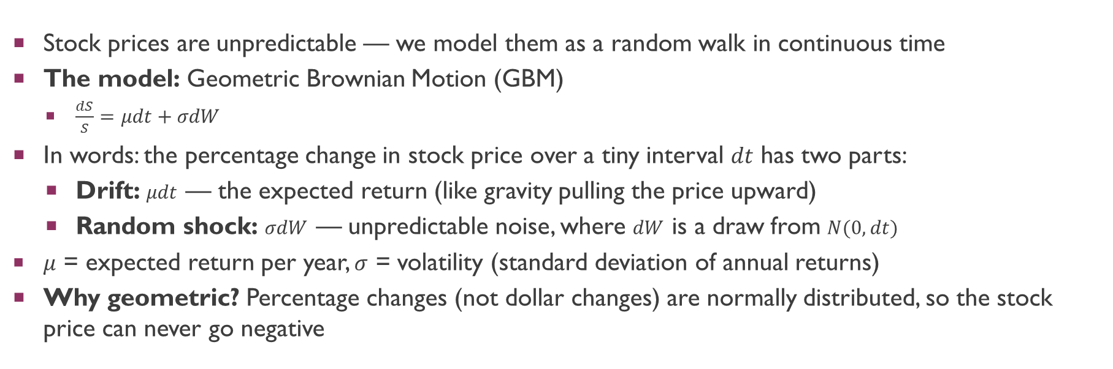
Step 1: Modelling Stock Price Movements
Stock prices are unpredictable — we model them as a random walk in continuous time
The model: Geometric Brownian Motion (GBM)
$\frac{dS}{S}=μdt+σdW$
In words: the percentage change in stock price over a tiny interval $dt$ has two parts:
Drift: $μdt$ — the expected return (like gravity pulling the price upward)
Random shock: $σdW$ — unpredictable noise, where $dW$ is a draw from $N(0,dt)$
$μ$ = expected return per year, $σ$ = volatility (standard deviation of annual returns)
Why geometric? Percentage changes (not dollar changes) are normally distributed, so the stock price can never go negative

Slide 47
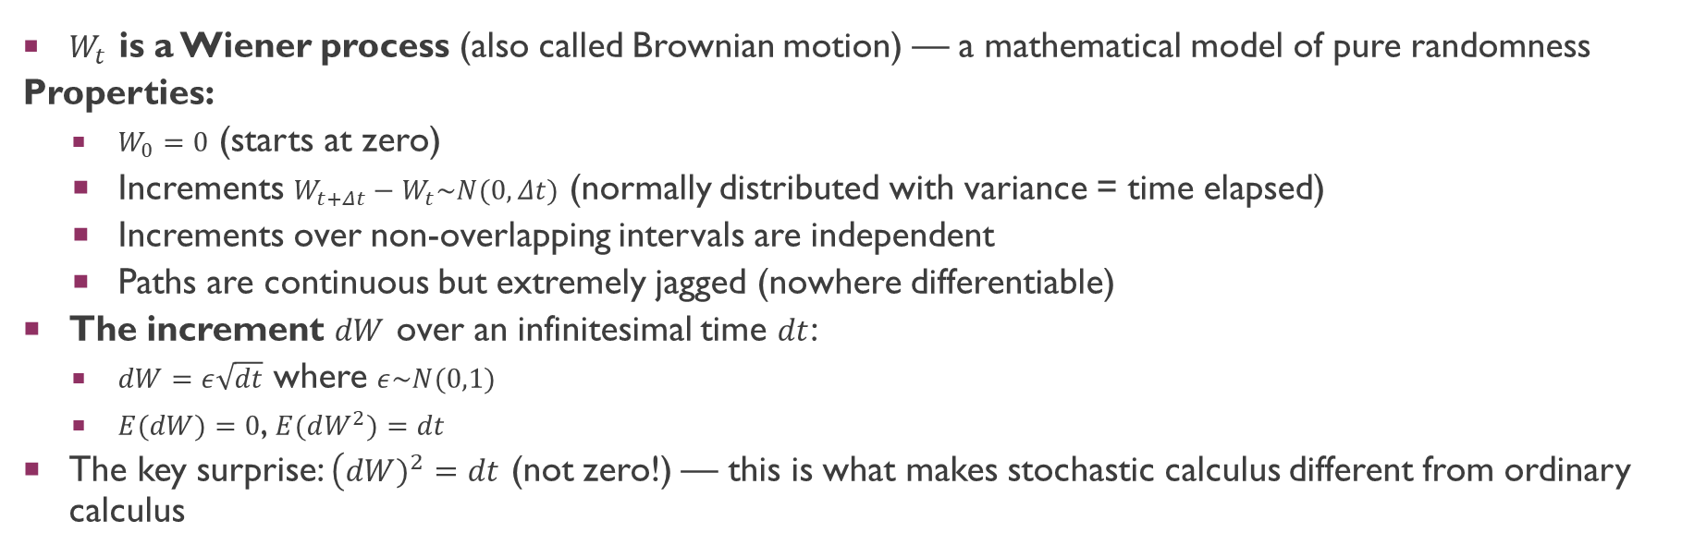
Step 1 (cont.): The Wiener Process W
$W_{t}$ is a Wiener process (also called Brownian motion) — a mathematical model of pure randomness
Properties:
$W_{0}=0$ (starts at zero)
Increments $W_{t+Δt}−W_{t}\sim N(0,Δt)$ (normally distributed with variance = time elapsed)
Increments over non-overlapping intervals are independent
Paths are continuous but extremely jagged (nowhere differentiable)
The increment $dW$ over an infinitesimal time $dt$:
$dW=ε\sqrt{dt}$ where $ε\sim N(0,1)$
$E(dW)=0$, $E(dW^{2})=dt$
The key surprise: $\left(dW)^{2} = dt\right.$ (not zero!) — this is what makes stochastic calculus different from ordinary calculus

Slide 48
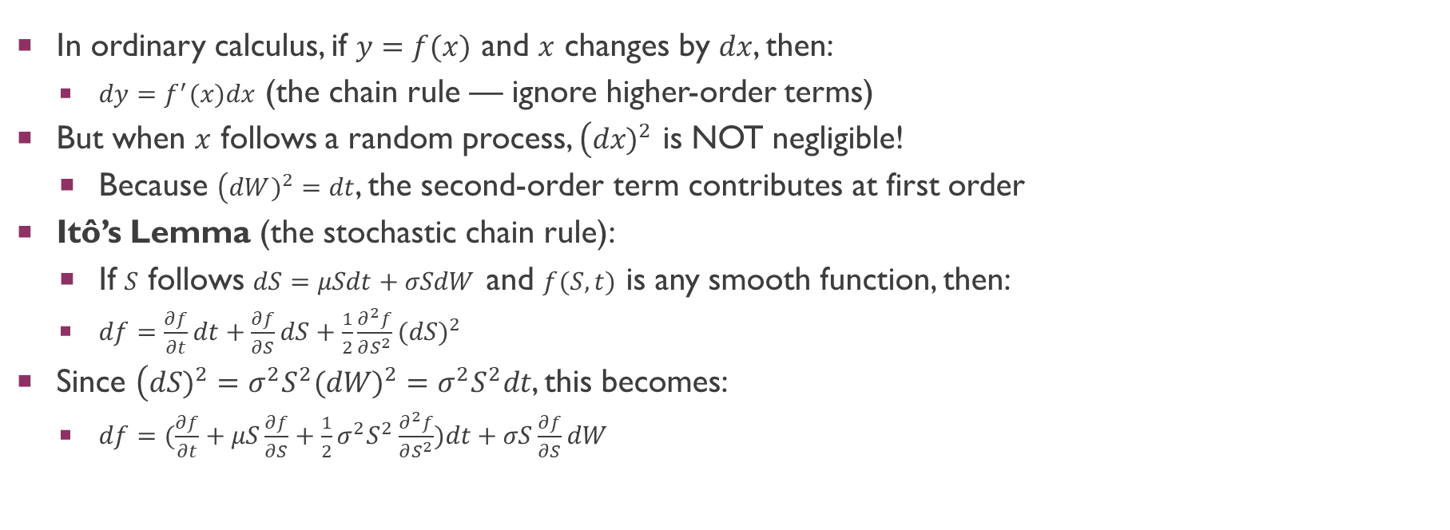
Step 2: Itô’s Lemma — Why We Need a New Chain Rule
In ordinary calculus, if $y=f(x)$ and $x$ changes by $dx$, then:
$dy=f^{′}(x)dx$ (the chain rule — ignore higher-order terms)
But when $x$ follows a random process, $\left(dx)^{2}\right.$ is NOT negligible!
Because $\left(dW)^{2} = dt\right.$, the second-order term contributes at first order
Itô’s Lemma (the stochastic chain rule):
If $S$ follows $dS=μSdt+σSdW$ and $f(S,t)$ is any smooth function, then:
$df=\frac{∂f}{∂t}dt+\frac{∂f}{∂S}dS+\frac{1}{2}\frac{∂^{2}f}{∂S^{2}}(dS)^{2}$
Since $\left(dS)^{2}=σ^{2}S^{2}(dW)^{2}=σ^{2}S^{2}dt\right.$, this becomes:
$df=(\frac{∂f}{∂t}+μS\frac{∂f}{∂S}+\frac{1}{2}σ^{2}S^{2}\frac{∂^{2}f}{∂S^{2}})dt+σS\frac{∂f}{∂S}dW$

Slide 49
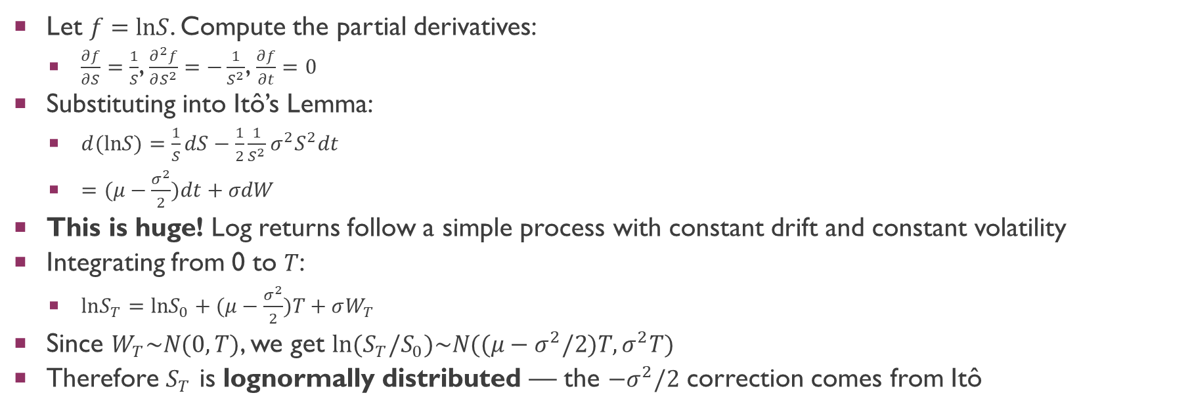
Step 2 (cont.): Applying Itô’s Lemma to ln(S)
Let $f=lnS$. Compute the partial derivatives:
$\frac{∂f}{∂S}=\frac{1}{S}$, $\frac{∂^{2}f}{∂S^{2}}=−\frac{1}{S^{2}}$, $\frac{∂f}{∂t}=0$
Substituting into Itô’s Lemma:
$d(lnS)=\frac{1}{S}dS−\frac{1}{2}\frac{1}{S^{2}}σ^{2}S^{2}dt$
$=(μ−\frac{σ^{2}}{2})dt+σdW$
This is huge! Log returns follow a simple process with constant drift and constant volatility
Integrating from 0 to $T$:
$lnS_{T}=lnS_{0}+(μ−\frac{σ^{2}}{2})T+σW_{T}$
Since $W_{T}\sim N(0,T)$, we get $ln(S_{T}/S_{0})\sim N((μ−σ^{2}/2)T,σ^{2}T)$
Therefore $S_{T}$ is lognormally distributed — the $−σ^{2}/2$ correction comes from Itô

Slide 50
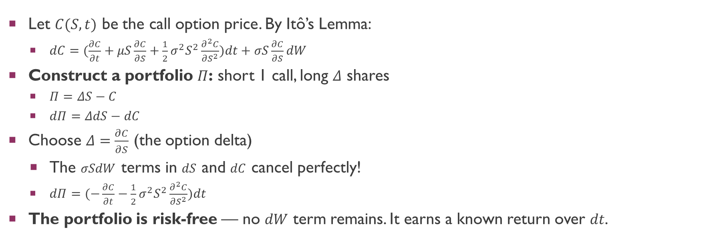
Step 3: Building a Risk-Free Portfolio
Let $C(S,t)$ be the call option price. By Itô’s Lemma:
$dC=(\frac{∂C}{∂t}+μS\frac{∂C}{∂S}+\frac{1}{2}σ^{2}S^{2}\frac{∂^{2}C}{∂S^{2}})dt+σS\frac{∂C}{∂S}dW$
Construct a portfolio $Π$: short 1 call, long $Δ$ shares
$Π=ΔS−C$
$dΠ=ΔdS−dC$
Choose $Δ=\frac{∂C}{∂S}$ (the option delta)
The $σSdW$ terms in $dS$ and $dC$ cancel perfectly!
$dΠ=(−\frac{∂C}{∂t}−\frac{1}{2}σ^{2}S^{2}\frac{∂^{2}C}{∂S^{2}})dt$
The portfolio is risk-free — no $dW$ term remains. It earns a known return over $dt$.

Slide 51
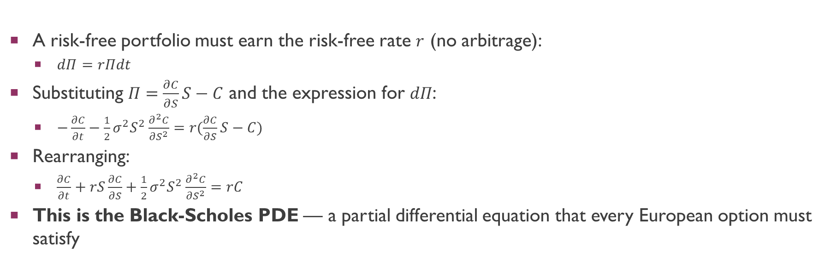
Step 4: The Black-Scholes PDE
A risk-free portfolio must earn the risk-free rate $r$ (no arbitrage):
$dΠ=rΠdt$
Substituting $Π=\frac{∂C}{∂S}S−C$ and the expression for $dΠ$:
$−\frac{∂C}{∂t}−\frac{1}{2}σ^{2}S^{2}\frac{∂^{2}C}{∂S^{2}}=r(\frac{∂C}{∂S}S−C)$
Rearranging:
$\frac{∂C}{∂t}+rS\frac{∂C}{∂S}+\frac{1}{2}σ^{2}S^{2}\frac{∂^{2}C}{∂S^{2}}=rC$
This is the Black-Scholes PDE — a partial differential equation that every European option must satisfy

Slide 52
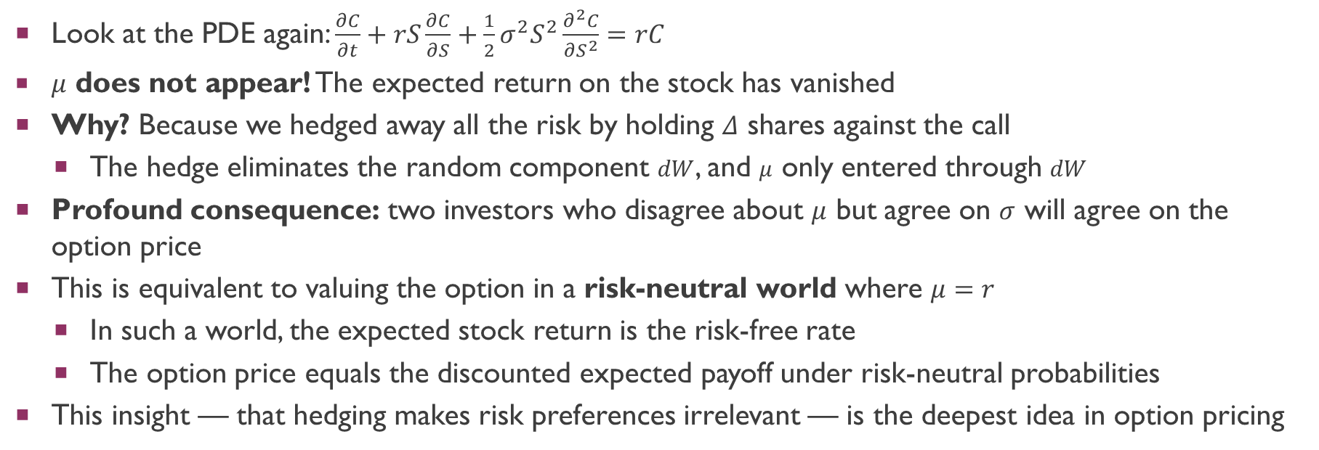
Step 5: The Disappearing μ
Look at the PDE again: $\frac{∂C}{∂t}+rS\frac{∂C}{∂S}+\frac{1}{2}σ^{2}S^{2}\frac{∂^{2}C}{∂S^{2}}=rC$
$μ$ does not appear! The expected return on the stock has vanished
Why? Because we hedged away all the risk by holding $Δ$ shares against the call
The hedge eliminates the random component $dW$, and $μ$ only entered through $dW$
Profound consequence: two investors who disagree about $μ$ but agree on $σ$ will agree on the option price
This is equivalent to valuing the option in a risk-neutral world where $μ=r$
In such a world, the expected stock return is the risk-free rate
The option price equals the discounted expected payoff under risk-neutral probabilities
This insight — that hedging makes risk preferences irrelevant — is the deepest idea in option pricing

Slide 53
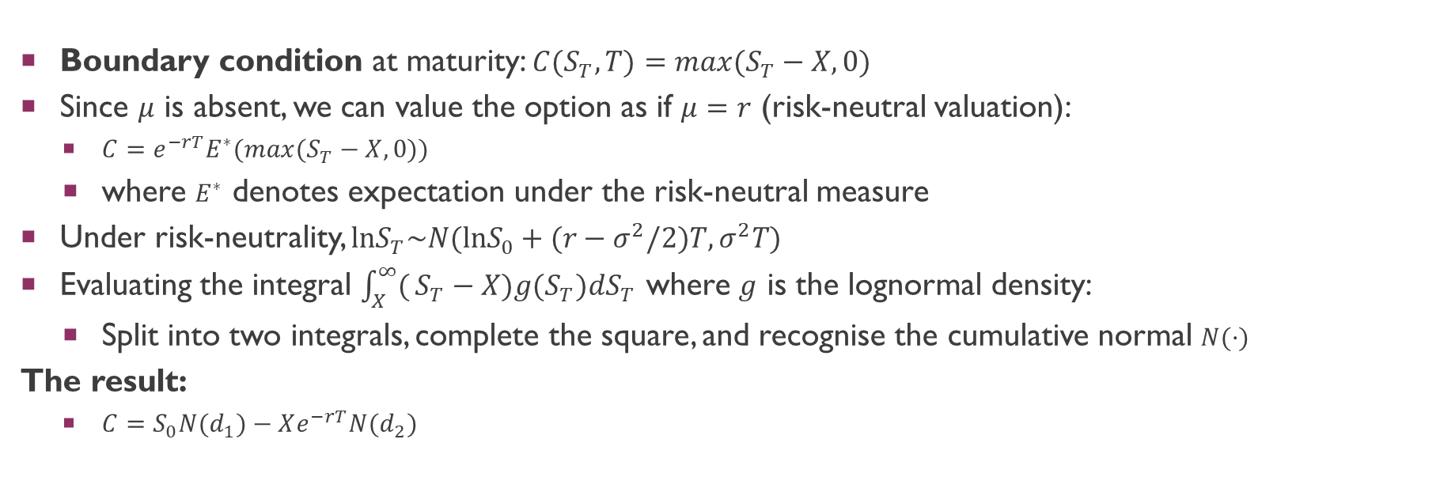
Step 6: Solving the PDE
Boundary condition at maturity: $C(S_{T},T)=max(S_{T}−X,0)$
Since $μ$ is absent, we can value the option as if $μ=r$ (risk-neutral valuation):
$C=e^{−rT}E^{∗}(max(S_{T}−X,0))$
where $E^{∗}$ denotes expectation under the risk-neutral measure
Under risk-neutrality, $lnS_{T}\sim N(lnS_{0}+(r−σ^{2}/2)T,σ^{2}T)$
Evaluating the integral $\int_{X}^{∞}{(}S_{T}−X)g(S_{T})dS_{T}$ where $g$ is the lognormal density:
Split into two integrals, complete the square, and recognise the cumulative normal $N(·)$
The result:
$C=S_{0}N(d_{1})−Xe^{−rT}N(d_{2})$

Slide 54

Step 7: The Formula and Its Meaning
$$C=S·N(d_{1})−PV(X)·N(d_{2})$$
where $d_{1}=\frac{ln(S/X)+(r+σ^{2}/2)T}{σ\sqrt{T}}$ and $d_{2}=d_{1}−σ\sqrt{T}$
$N(d_{2})$ = probability the option expires in the money (under risk-neutral measure)
$PV(X)·N(d_{2})$ = expected present value of the exercise price payment
$N(d_{1})$ = probability-weighted fraction of the share you receive
$S·N(d_{1})$ = expected present value of receiving the share
Note: $N(d_{1})$ is computed under a different probability measure (share as numeraire) — this is why $d_{1}≠d_{2}$
The difference $d_{1}−d_{2}=σ\sqrt{T}$ captures the volatility adjustment between the two measures
The option delta $\frac{∂C}{∂S}=N(d_{1})$ — exactly the hedge ratio we used to derive the PDE

Slide 55

The Big Intuition: Why Black-Scholes Works
Option pricing = replication, not forecasting
We never predict where the stock price will go — we build a portfolio that matches the option payoff in every scenario
Think of it like insurance pricing:
An insurer doesn’t predict whether your house will burn down
They calculate the cost of hedging the risk by diversifying across many policies
Similarly, Black-Scholes calculates the cost of continuously hedging the option by trading stock
The hedge eliminates all risk → risk preferences become irrelevant
A risk-averse investor and a risk-loving gambler agree on the option price
Because neither is bearing any risk — the hedge portfolio is risk-free
What matters is $σ$, not $μ$:
The expected return $μ$ washes out through hedging
Only volatility $σ$ matters — it determines how much hedging costs
Higher volatility = more expensive to hedge = more valuable option

Slide 56

Black-Scholes: Summary of Assumptions
Stock price follows GBM with constant $σ$ (no jumps, constant volatility)
Continuous trading is possible (can rebalance the hedge at every instant)
No transaction costs or taxes (hedging is frictionless)
Risk-free rate $r$ is constant and borrowing/lending is unlimited
No dividends during the option’s life (can be relaxed with adjustments)
European exercise only (American options require modifications)
When assumptions fail:
Volatility is not constant → volatility smile/skew (implied vol varies by strike)
Jumps in stock prices → jump-diffusion models (Merton, 1976)
Transaction costs → hedge imperfectly, widen bid-ask spreads
Despite these limitations, Black-Scholes remains the benchmark — practitioners adjust around it rather than replacing it

